Slide 1
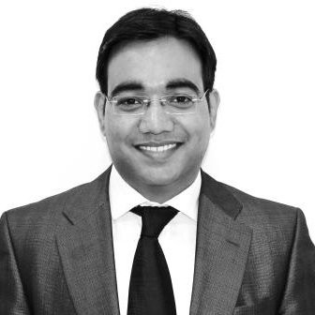
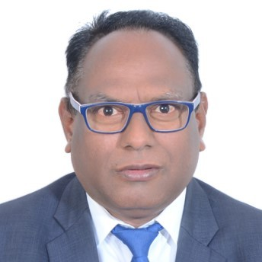
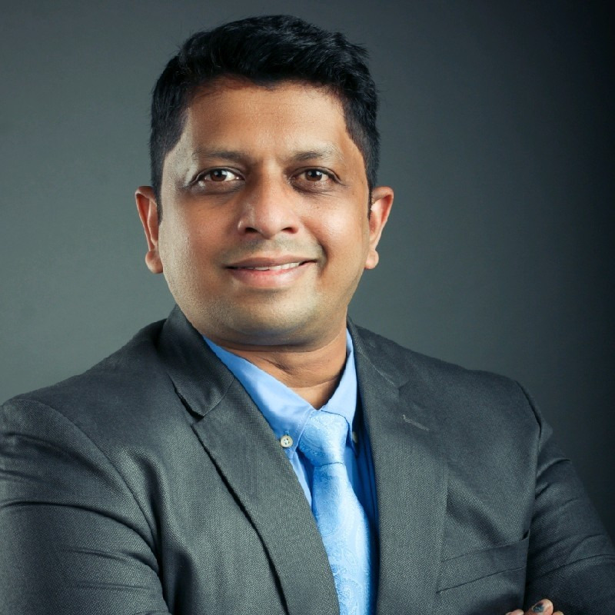
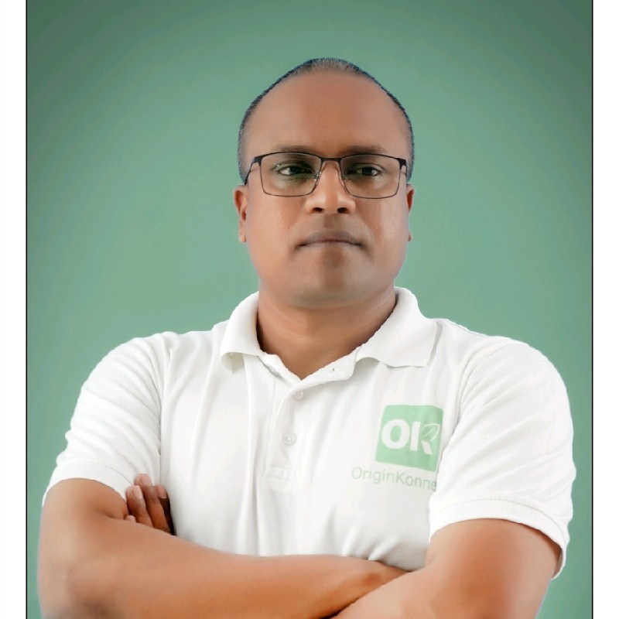
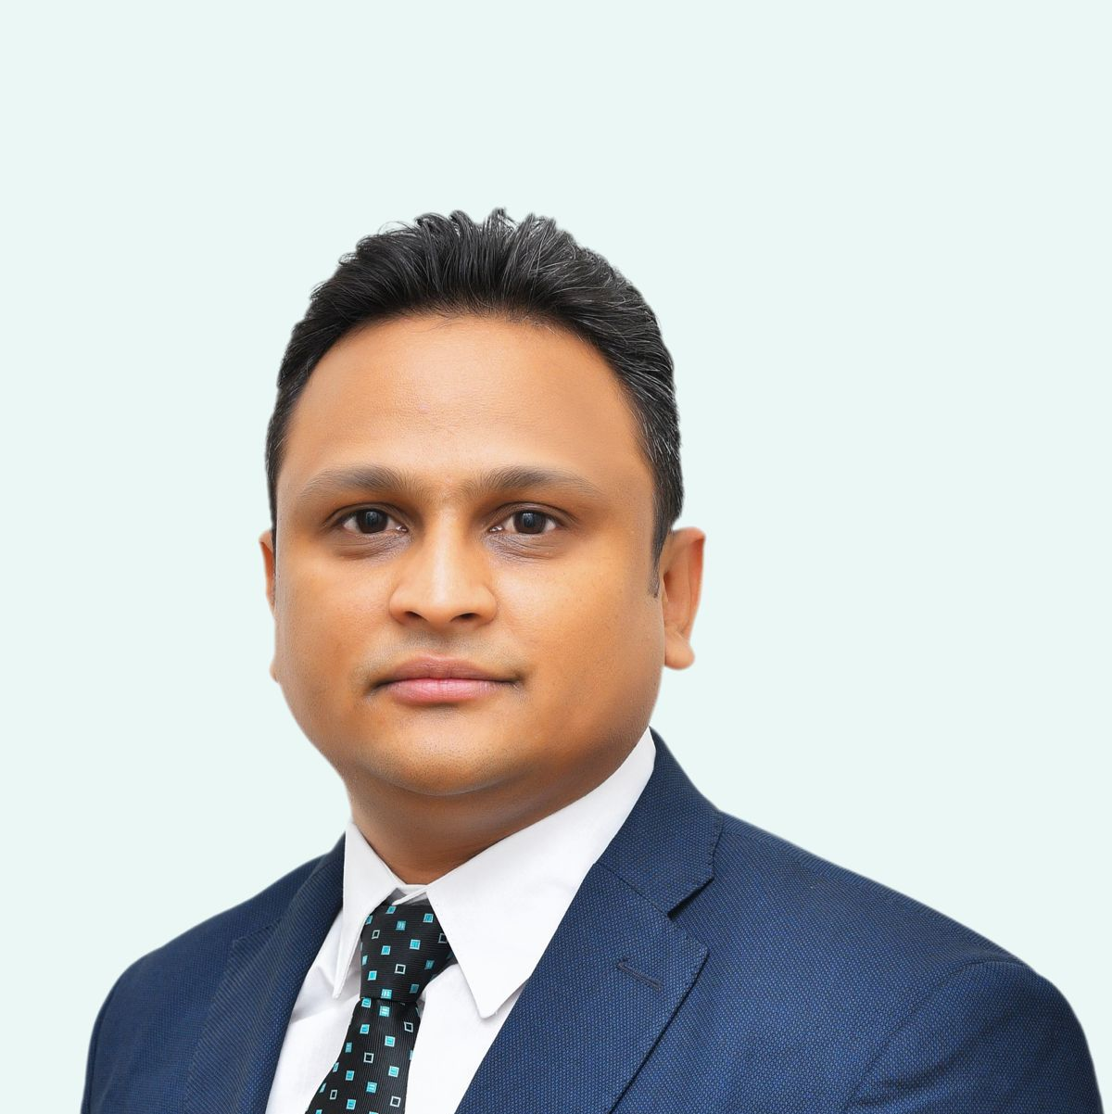
Horticulture Value Chain Summit
Marketing and Export of Horticultural Commodities and Horti-startups
Opening Remarks on “Export Opportunities for the Indian Horticulture”
Chirag Jain
  Partner, Grant Thornton Bharat LLP
Moderated by
Mr. Nagpal C Lokhare
  DGM, APEDA, Ministry of Commerce & Industry
Mr. Suman Roy Choudhary
  Director, Absolute Foods
Mr. Ravish Kumar
  Co-Founder, COO, OriginKonnect
Dr. Anup Karwa
  Director, Desai Agri Foods

Slide 2
Nagpal C Lokhare, Deputy General Manager APEDA, Ministry of Commerce & Industry
MSc Agri (Plant Pathology) (First Class with Distinction; Year of pass out: Sept 1999)
Completed education from Dr. Panjabrao Deshmukh Agricultural University, Akola (Maharashtra)
Experience: 12 years work in Maharashtra State Seeds Corporation (MAHABEEJ), Akola as Assistant Field Officer.
Past working experience in MAHABEEJ: Seed Production, Seed Processing, Quality Supervision at field level, Formulation of Bio-fungicides, Bio-pesticides like Trichoderma, Beuvaria basiana, Biofertilizer production and Marketing of Seeds. Implementation of Food Safety Management System (FSMS) and HACCP Plan in the Seed processing Unit.
Experience in APEDA: 7 years Dealing with various important assignments like Market Access, trial shipment of Horticulture produce to new Markets, Sanitary Phytosanitary (SPS)/Technical Barrier for Trade (TBT) issues of importing countries. Providing need base advisory services to State authorities for implementation of Agri Export Policy, production of export worthy & residue free produce.
Lead Instructor and Inspector for Food Safety Preventive Control Alliance (FSPCA), USA
Represented India in Better Training for Safer Food (BTSF) organized by European Commission held at Lisbon, Portugal.
Represented India with trade delegations in International Trade Fair, Berlin (Germany), Sydney (Australia), Colombo (Sri Lanka)

Slide 3
Suman Roy Choudhary, Director
Absolute Foods
Head InsureTech, Absolute Group
15 + years of rich experience in scaling insurance business in agriculture and rural industry by using State of art Technological innovations in the past. He has managed various Indian geographies and has helped in getting 4.2 million farmers insured. He has built lot of innovative solutions using IOT, AI – ML models and Remote Sensing, which is now helping the insurance industry to change the dynamics of the entire Crop insurance. He has done his MBA from WBUT Kolkata.

Slide 4
Ravish Kumar, Co-founder & COO
OriginKonnect
Serial Agri food entrepreneur
In 14+ years, Ravish experienced all different business formats as a retailer, wholesaler, supplier to HORECA, supplier to exporters and exporters. With this rich experience in the agri-food segment he understands real value chain issues very well & its passionate to solve them, so every entity should benefit.
Ravish believes that most of the issues across the agri-food value chain are due to lack of trust and which can be fixed by the use of technology by providing seamless visibility.

Slide 5
Dr. Anup Karwa, Director & CEO
Desai Agri Foods – a Innoterra company leading crops operation India
MSc in Molecular Genetics, University of Leicester, United Kingdom, MSc. Biosafety in Plant Biotechnology, Ancona, Italy (UNIDO Scholar) and a Phd in molecular biology from Forschungszentrum juelich in Germany (Marie curie scholar)
Passionate Bio-entrepreneur with 18+ years of product development and agribusiness leadership experience in plant breeding, agriculture farming and microbial technology. He holds more than 30 patents in plant breeding and microbial sciences. Recipient of Marie Curie, Cochran, UNIDO scholarships and Distinguished Alumni award from VIT University, Vellore. He is also research council board member for CSIR, Govt. of India, mentor at Niti Aayog and mentor for US-India Science & Technology Endowment fund.
Innoterra (formerly pioneering ventures) is a swiss- Indian food and technology platform company operating in 14 countries and has its HO at Mumbai. It is present in pan India since last 22 years and has about 1000 employees. Innoterra is widely covered by the International media and Forbes as hottest emerging ag-tech platform company. Desai Agri-foods is largest exporter of bananas from India (5000+ container exported) and operates fully backwards integrated supply chains for Bananas, Pomegranate, Mangoes , Grapes and Pineapple.

Slide 6

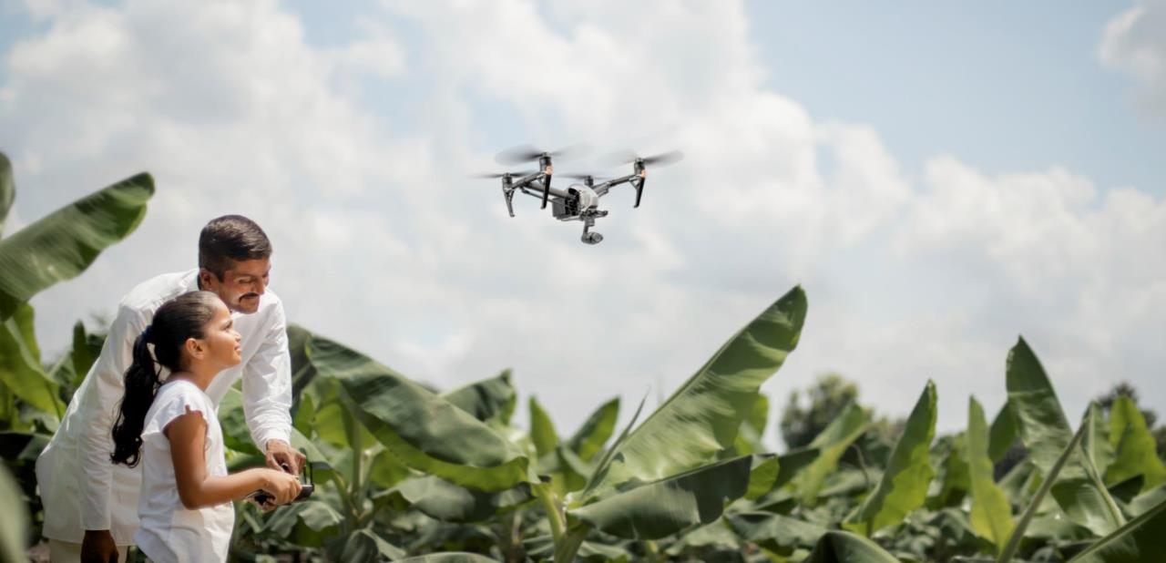
Banana Cluster Development
Science Driven Cultivation

Slide 7
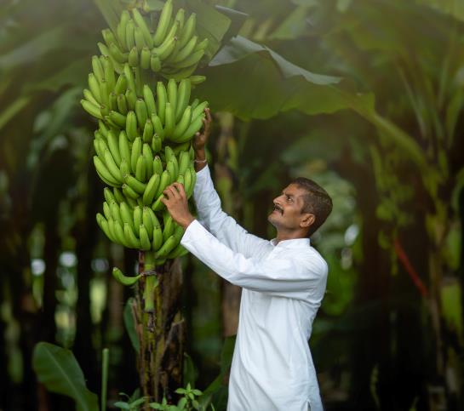
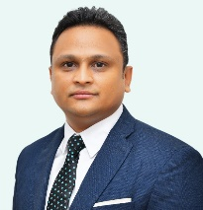
About Innoterra & Desai AgriFoods
Innoterra (formerly Pioneering Ventures) is a Swiss-Indian food and technology platform company operating in 14 countries and has its head office at Mumbai.
It is present in pan India since last 22 years and has about 1000 employees. Innoterra is widely covered by international media and Forbes as hottest emerging ag-tech platform company. Desai AgriFoods is largest exporter of bananas from India (5000+ containers exported) and operates fully backwards integrated supply chains for Bananas, Pomegranates, Mangos, Grapes and Pineapple.
Dr. Anup Karwa is Director & CEO for Crops India at Innoterra Group.
Anup is a serial AgBio-Entrepreneur with 18+ years of product development and agribusiness leadership experience in plant breeding, agribiotech and microbial technology. He holds >30 patents in plant breeding and microbial sciences. He is Marie Curie, UNIDO, Cochran & SOCAP scholar. He is also research council board member for CSIR, Govt of India, mentor at Niti Aayog and mentor for United States-India Science & Technology Endowment Fund.
He holds a MSc in Molecular Genetics, University of Leicester, United Kingdom, MSc Biosafety in Plant Biotechnology, Ancona, Italy (UNIDO Scholar) and a PhD in Plant Molecular Biology at the Forschungszentrum Juelich in Germany where he was a Marie Curie Scholar.

Slide 8
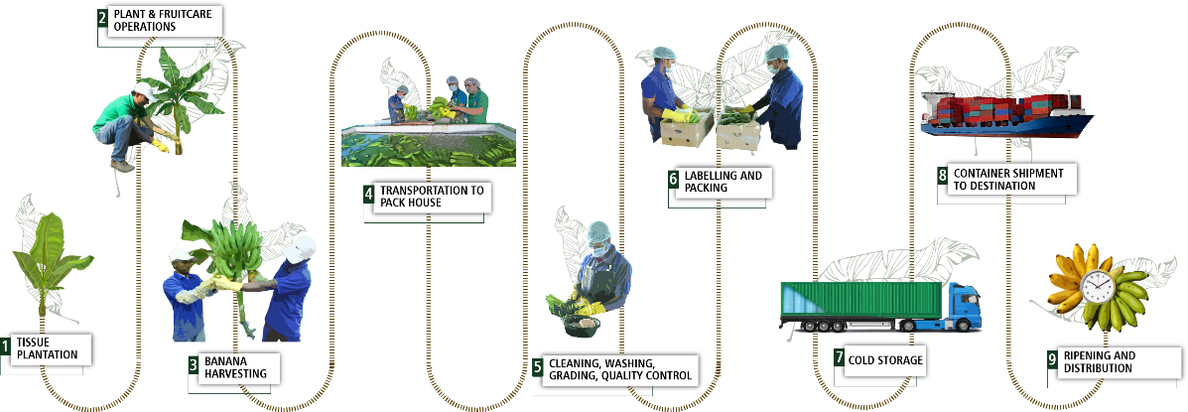
Premium Happy Banana Development

Slide 9
Science Driven Banana Farming in India 1/2
Stringent Quality Audits
(Surveys, Traceability, Dispatch & Arrival Scores)
Integrated Nutrition And Pest Management
(Soil & Leaf Tests, Biologicals & Drone Sprays)
Propritary Plant & Fruit Care Practices
(More bunch weight yeild per plant)
Unique Post-harvesting Processes
(Mobile & fixed packhouses, cable ways, precooling & cold storage)
Ensure Pre-Cultivation SOPs
(Land Preparation, Tissue per Acre, Drip Irrigation, Cover Crop-less weeds)
+15% bunches/acre
+20% bunch weight
65:25:10 ABC ratio +18% higher premium fruit

Slide 10
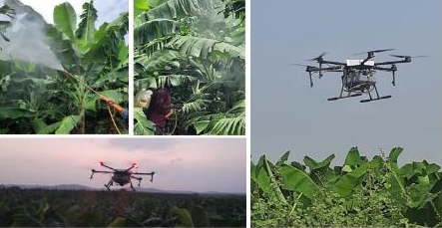
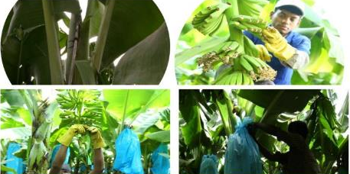
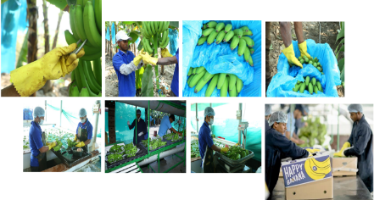
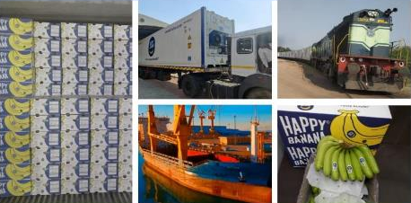
Science Driven Banana Farming in India 2/2
Soil test, Drones, IoT, AI & ML
Fruit Care
Harvesting Processes
Post-harvest Management

Slide 11



India – Opportunities to make the world go Bananas!
India is excellently placed to cater to the key markets that are hungry for the most traded fruit in the world – bananas.
Canada
United States of America
Turkey
Morocco
Iraq
China
Japan
Algeria
Taiwan
Saudi
Arabia
Oman
Philippines
Burkinafaso
Yemen
Malaysia
Colombia
Tanzania
Others
Happy Fruits

Slide 12
Thank You

