Slide 1
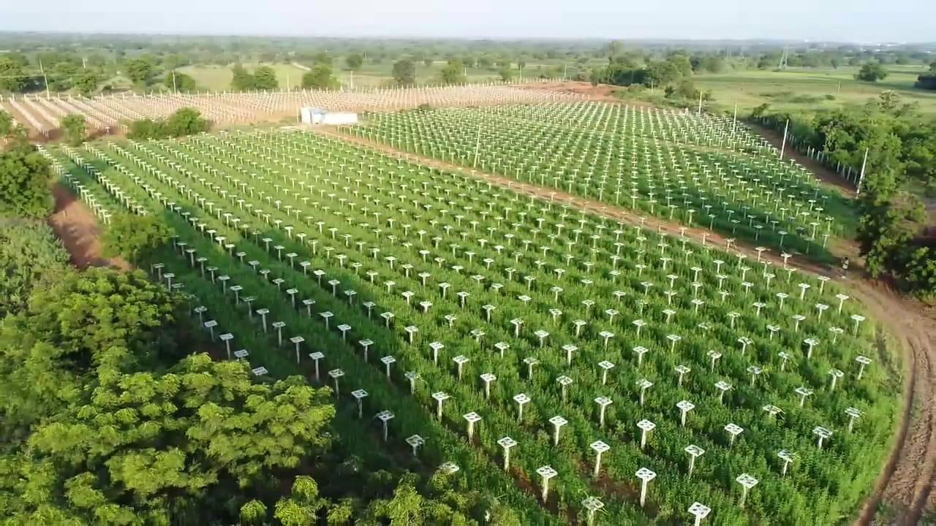
Deccan Exotics Dragon Fruit Farm
- Sangareddy
Dr. Srinivas Rao Madhavaram – M.B.B.S, M.D.

Slide 2
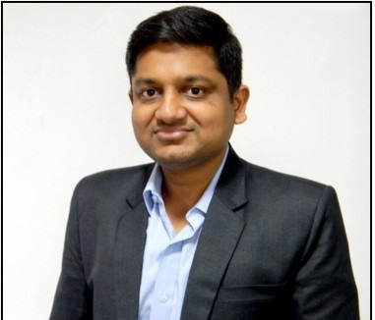
Introduction
Madhavaram Srinivas is a medical doctor by profession specialized in M.D (internal medicine ) with over 13 years of rich experience in treating patients.
With Dragon Fruit becoming increasingly popular in India in recent years, Deccan Exotics a Hyderabad-based farmers initiative has played a pivotal role in popularizing the fruit.
Back in 2016, Dr. Srinivas Rao, hailing from an agricultural family in Telangana decided to follow in his father’s footsteps Mr. Prasad Rao and pursue farming to help increase the economic viability of farmers.
Deccan Exotics was then launched in 2016 with the three primary goals;
1. To popularize and sustain Dragon Fruit farming and its consumption across India
2. Acquire and disseminate knowledge on dragon fruit cultivation to farmers
3. Engage in dragon fruit research, build plant diversity and conserve germplasm.
The primary intention was to promote a crop that made farming more economically viable. Hence, Dragon Fruit was the perfect answer.
Dr. M.Srinivas Rao
MBBS, M.D
(Internal Medicine)

Slide 3
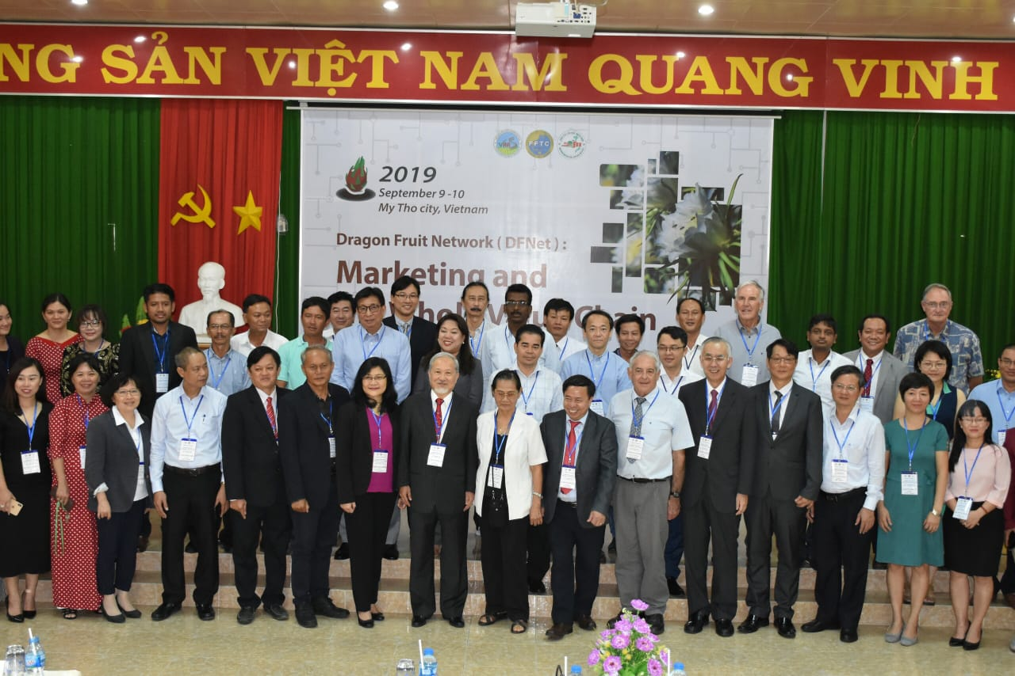
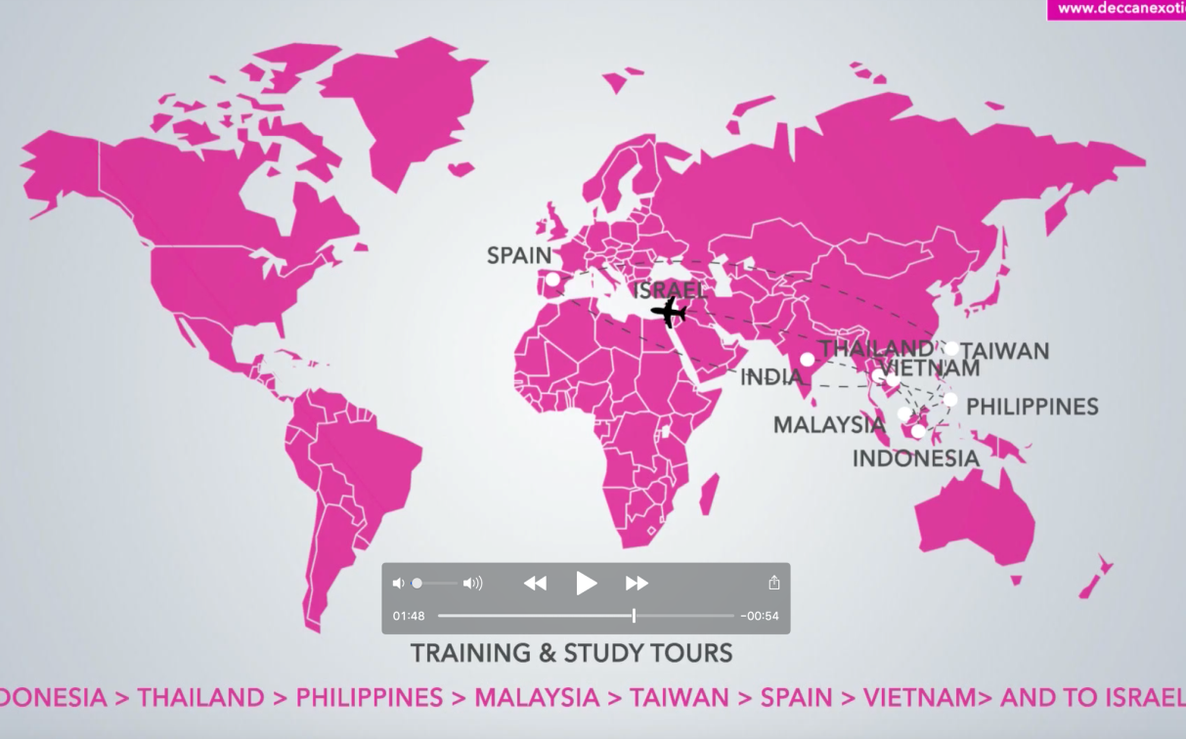
DECCAN EXOTICS part of prestigious “WORLD DRAGON FRUIT STEERING COMMITTEE" - 2019
Study tours to over 13 Countries in 3 years to learn dragon fruit cultivation

Slide 4

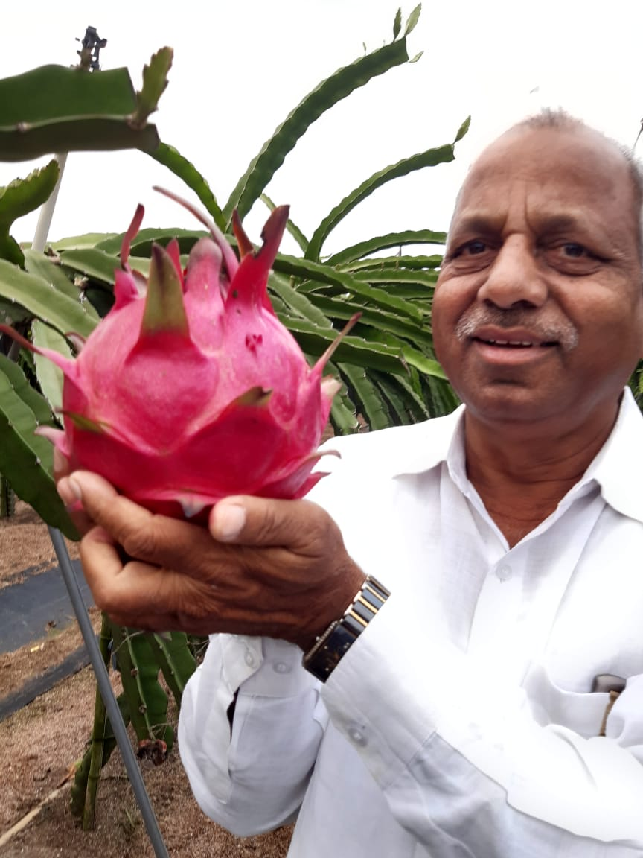
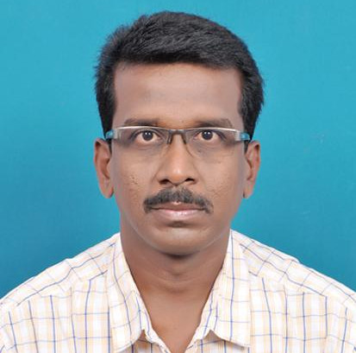
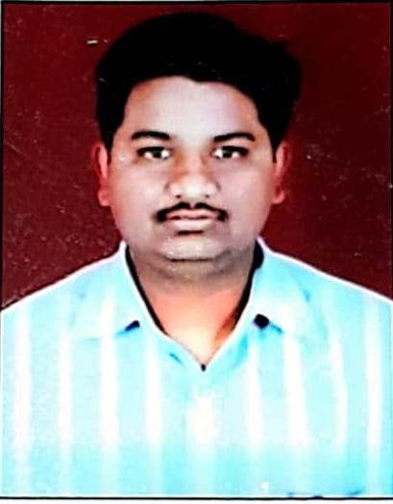

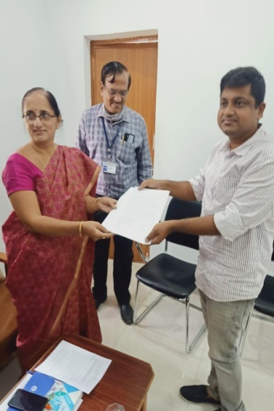
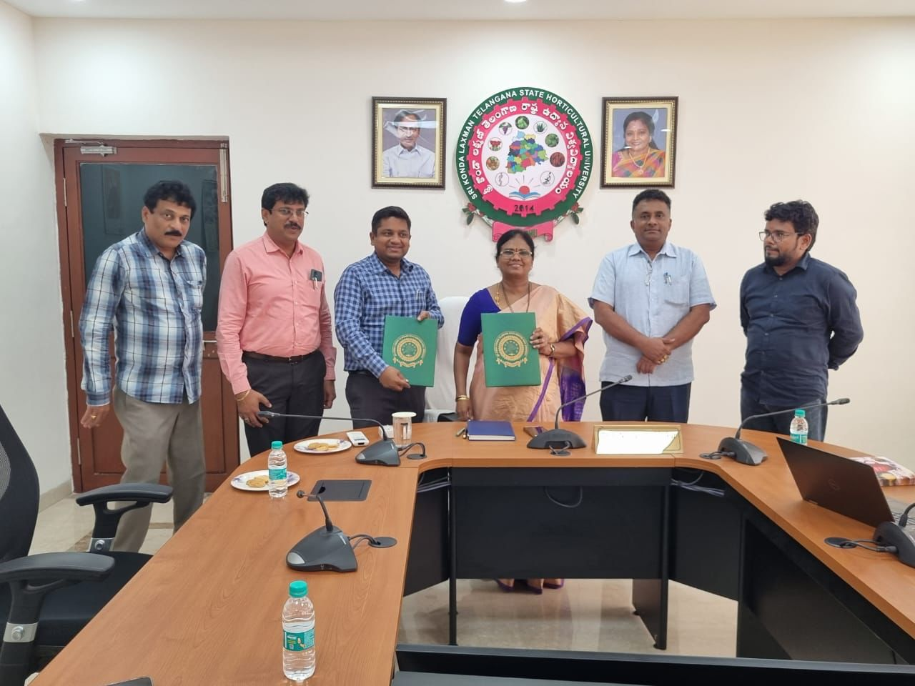


Express My Gratitude
Dr KARUNAKARAN
Principal Scientist & Head
IIHR
M Prasad Rao
M Chandrashekar Rao
Dr Anitha K
Principal Scientist
NBGPR
SKLTUH
Govt. of Telangana

Slide 5

Journey of Deccan Exotics
2015
2017
2019
2022
Approached SOFRI UNIVERSITY Vietnam.
Birth of DECCAN EXOTICS
Association with IIHR Tumkur
Guest speaker in IIHR-Tumkur
Member of World dragon fruit steering committee (expert panel)
Successful off season production commercially
SKLTUH MoU
Processing centre and integrated packhouse
Eureka
Tested dragon fruit for first time and seen in markets of Malaysia, Indonesia and visited local farms.
Enquiry about its growing conditions and feasibility about its cultivation with local agricultural officers.
Negative feedback and discouragement given by all of them
Started cultivation with 1,000 plants sourced locally from MAHARASHTRA - 70% mortality.
Attending Training programs across south east Asia and building up network with farmers and scientific community
R&D - off season production in India
Working on documentation of diseases in India with NBPGR.
Training sessions and collaborative assistance to more than 200 farmers across India & growing…
2016
2018
2020

Slide 6
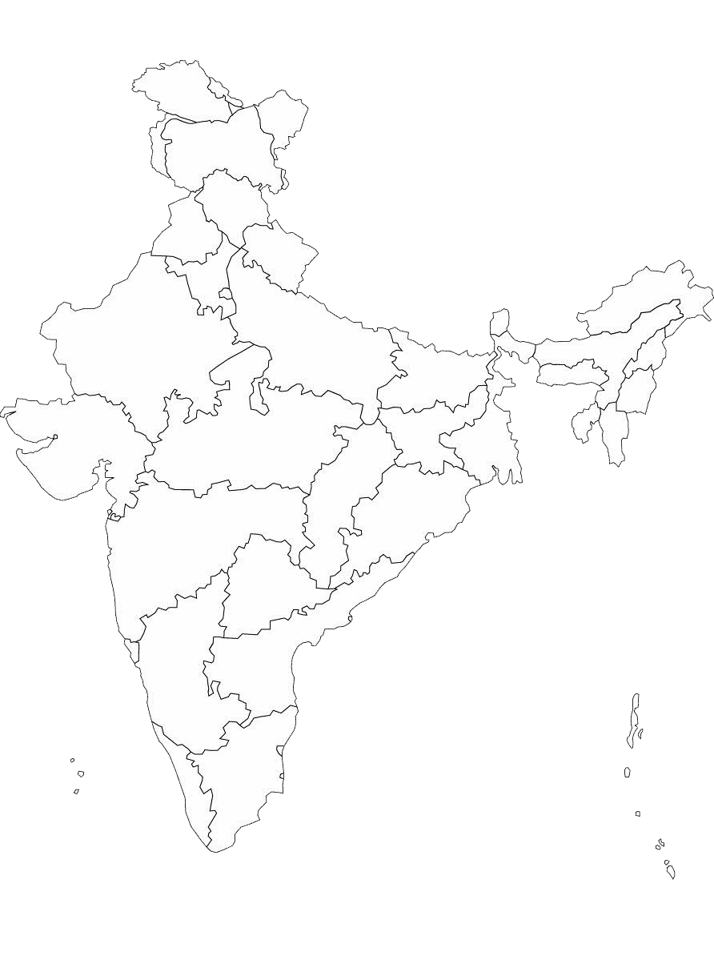























Pan India Presence of Deccan Exotics
Highlights
Network of over 800 farmers
Spread across 23 states
Awareness and training sessions to over 6000 farmers as to date.

Slide 7
VISION OF DECCAN EXOTICS
The aim of establishing the Deccan Farmer Producer Organization was multi-fold:
To Bridge the gap between farmers and the scientific community
To collect high yielding cultivars and distribute to farmers as per geographical conditions
To help farmers by disseminating technical information free of cost
To promote R&D activities and build a network of farmers across India
And, to create awareness about dragon fruit about Nutrient content and children awareness program

Slide 8
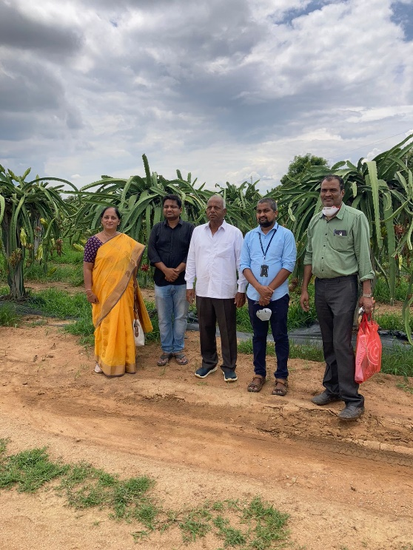
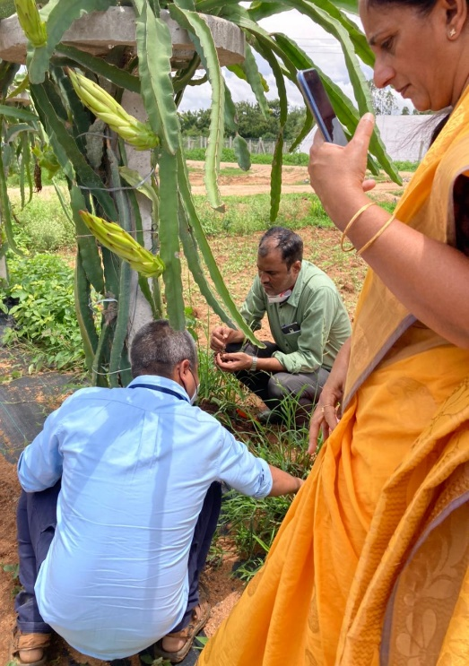
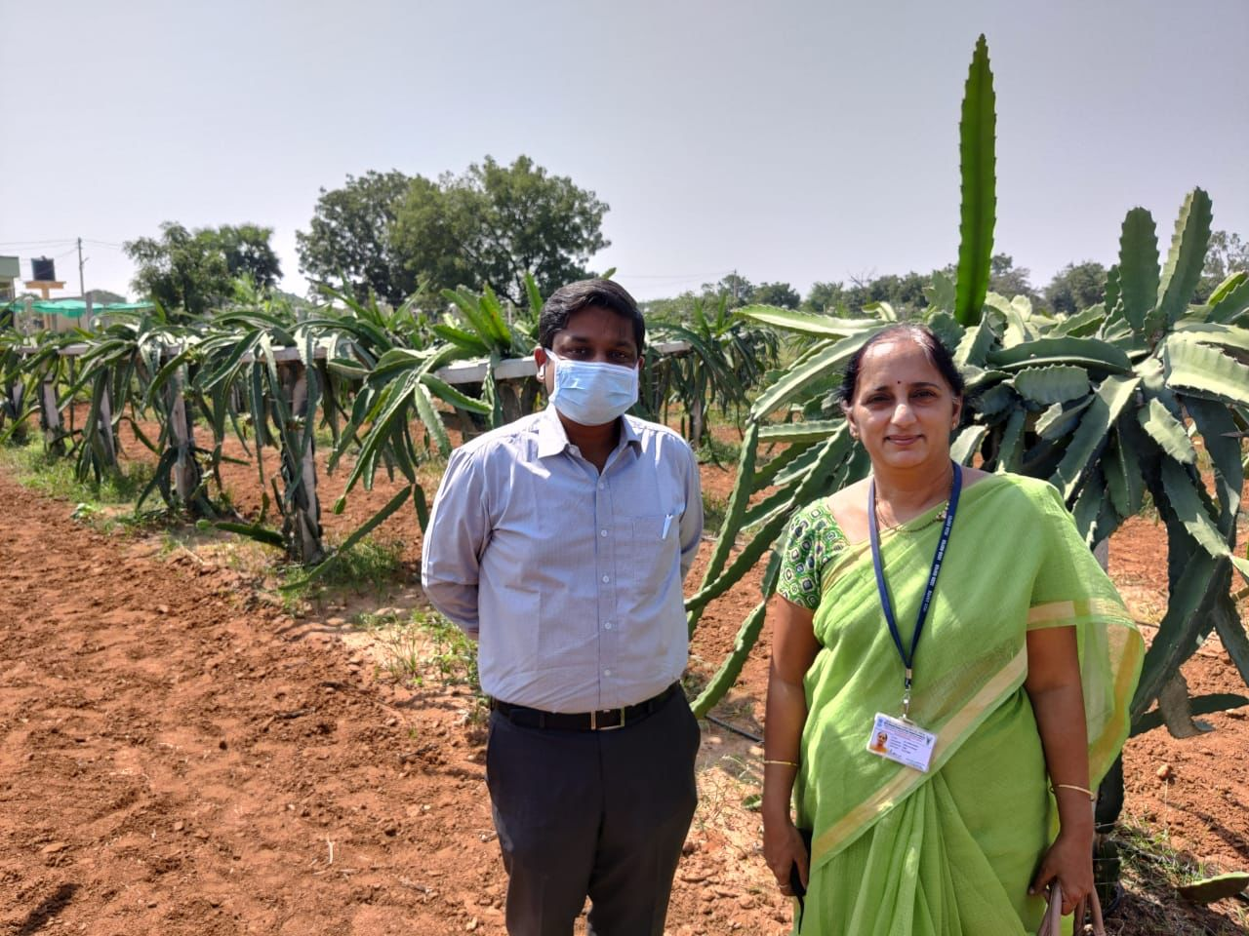
Contributions by Deccan Exotics
Deccan Exotics FPO has made many significant contributions towards capacity building in plant genetic resources management including:
Maintaining a field gene bank and has applied for permission to import various commercially grown cultivars through NBPGR since 2019.
Collaborating with NBPGR to identify and documentation of disease and pest management since 2019

Slide 9
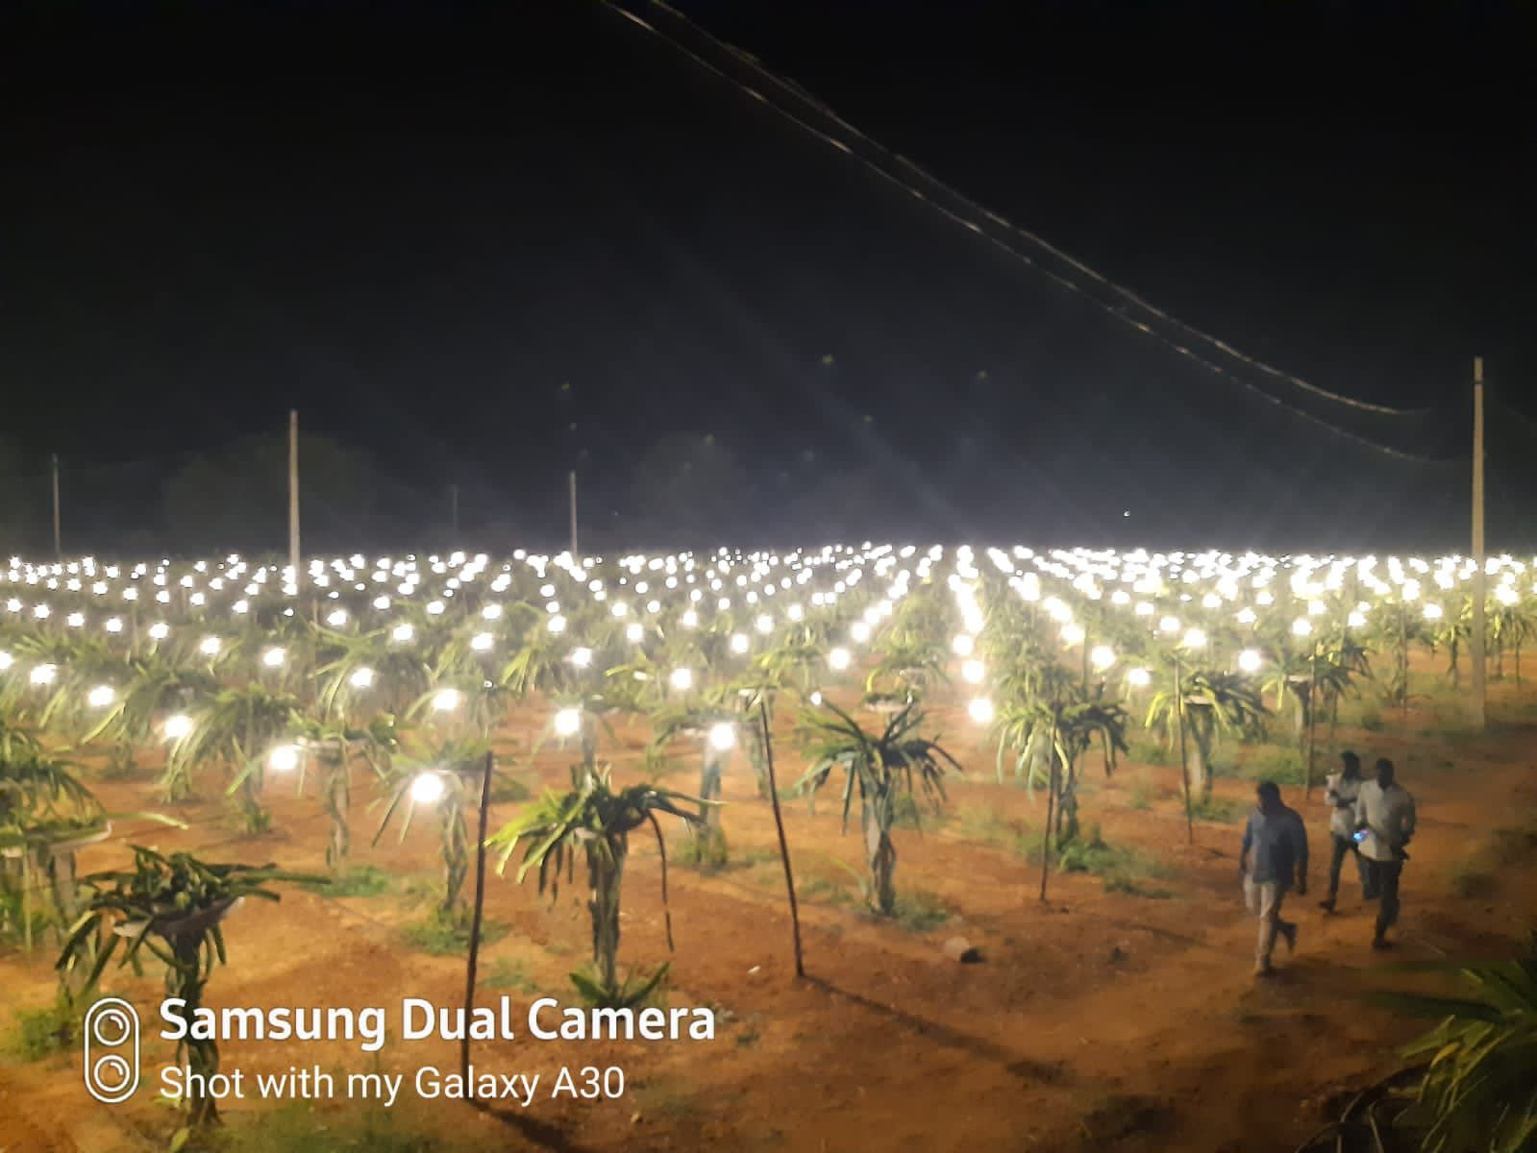
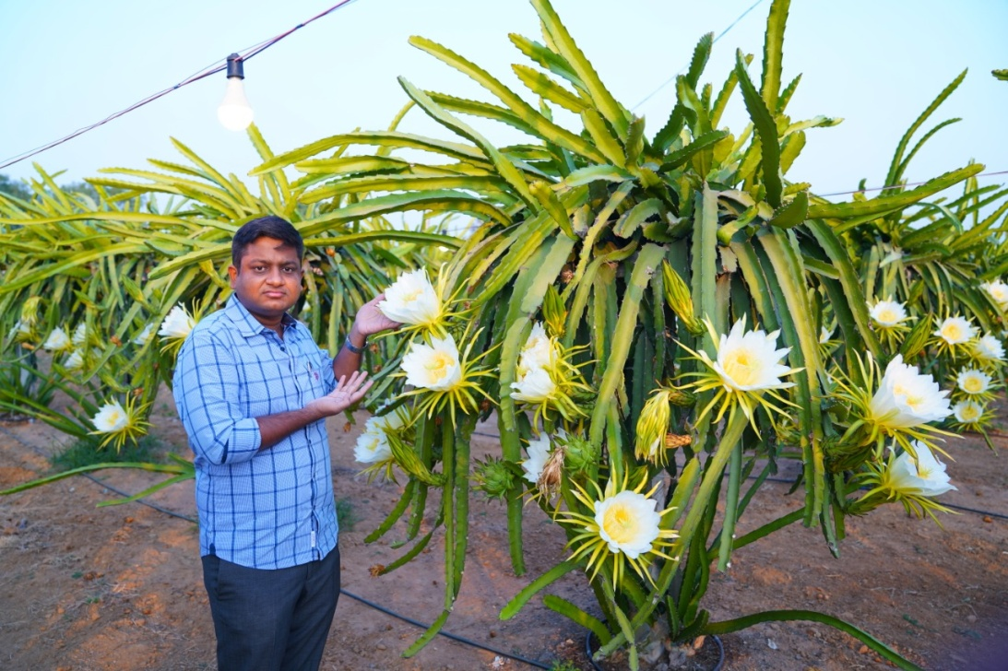
Contributions by Deccan Exotics
Deccan Exotics FPO has made many significant contributions towards capacity building in plant genetic resources management including:
Since 2018, engaged actively in research and innovation with off season production and increase the availability of fruit to 8 months a year

Slide 10
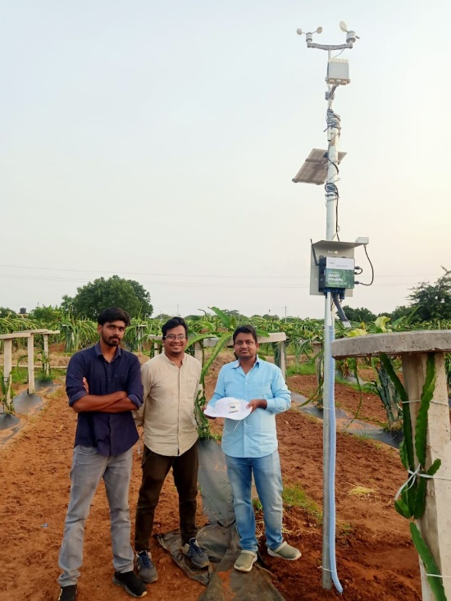
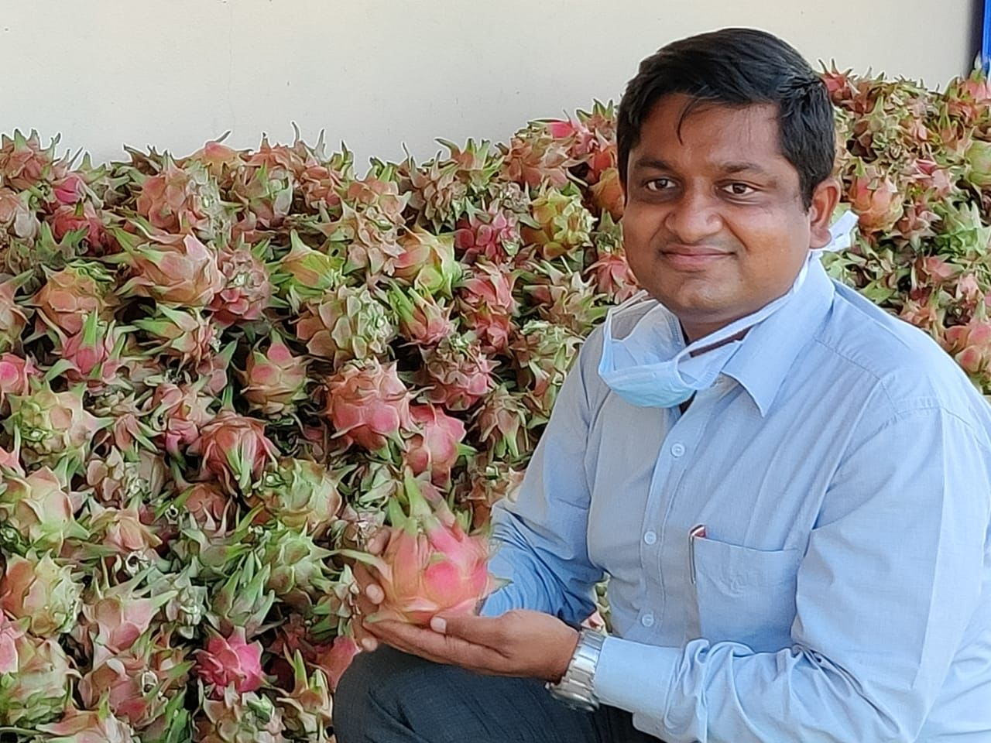
Contributions by Deccan Exotics
Deccan Exotics FPO has made many significant contributions towards capacity building in plant genetic resources management including:
Ensuring technical assistance and protocol standardization

Slide 11
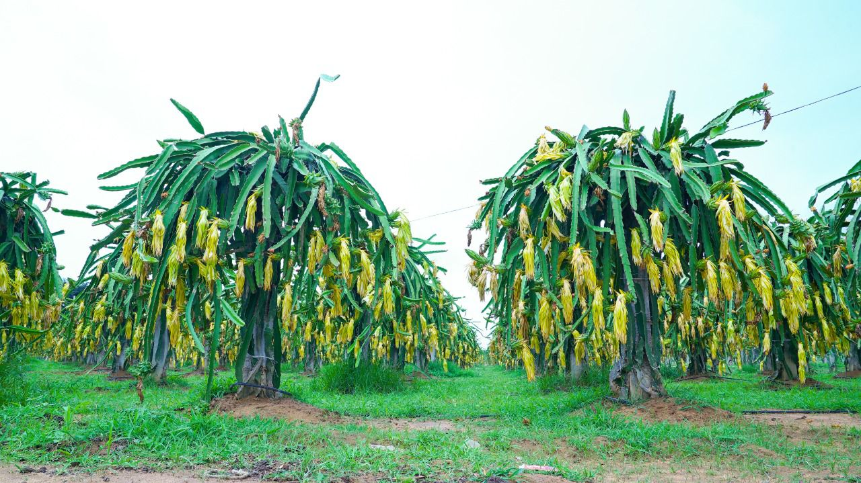
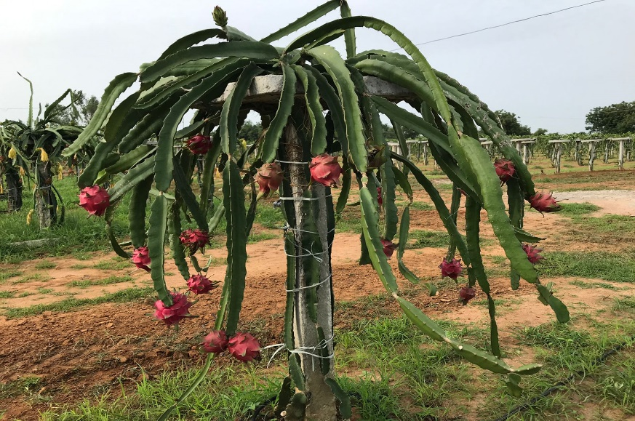
Contributions by Deccan Exotics
Deccan Exotics FPO has made many significant contributions towards capacity building in plant genetic resources management including:
Identification of high yield cultivar with superior qualities like:
  Fast growing
  High yield – upto 13 tonnes per acre
  Self pollinated
  Stress tolerance
  Disease resistance

Slide 12
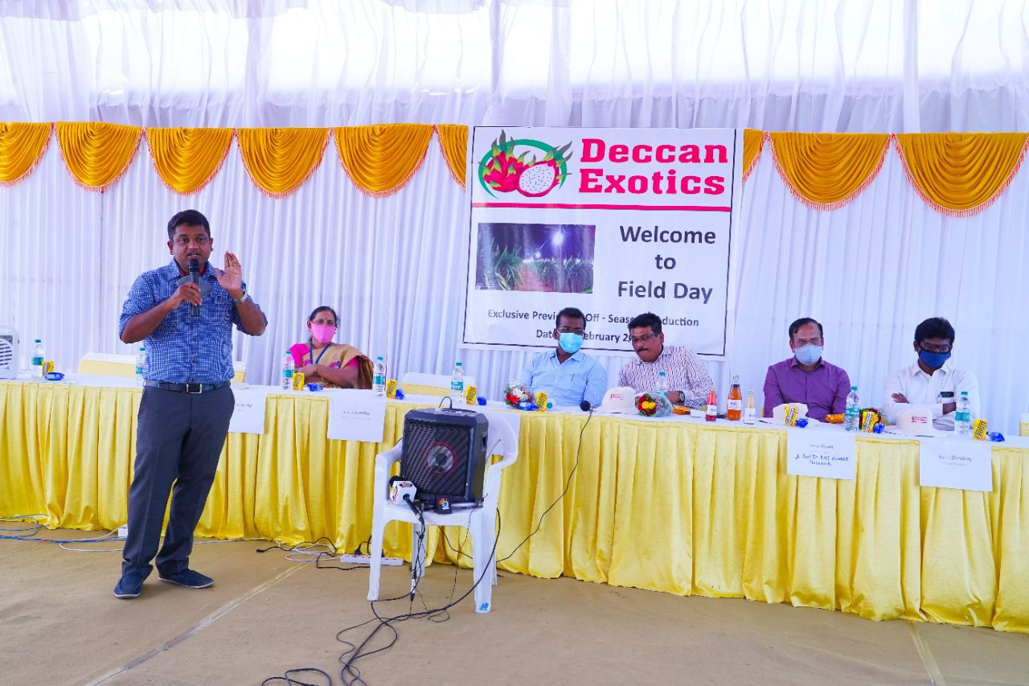
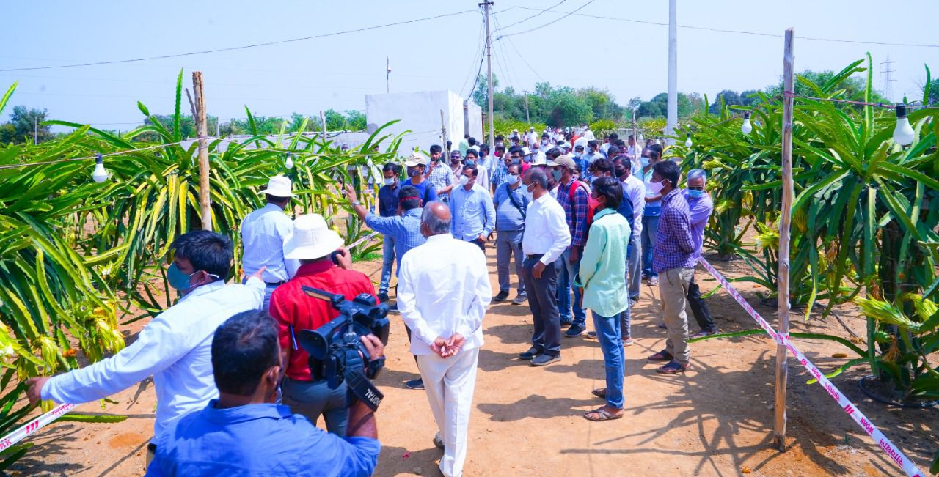
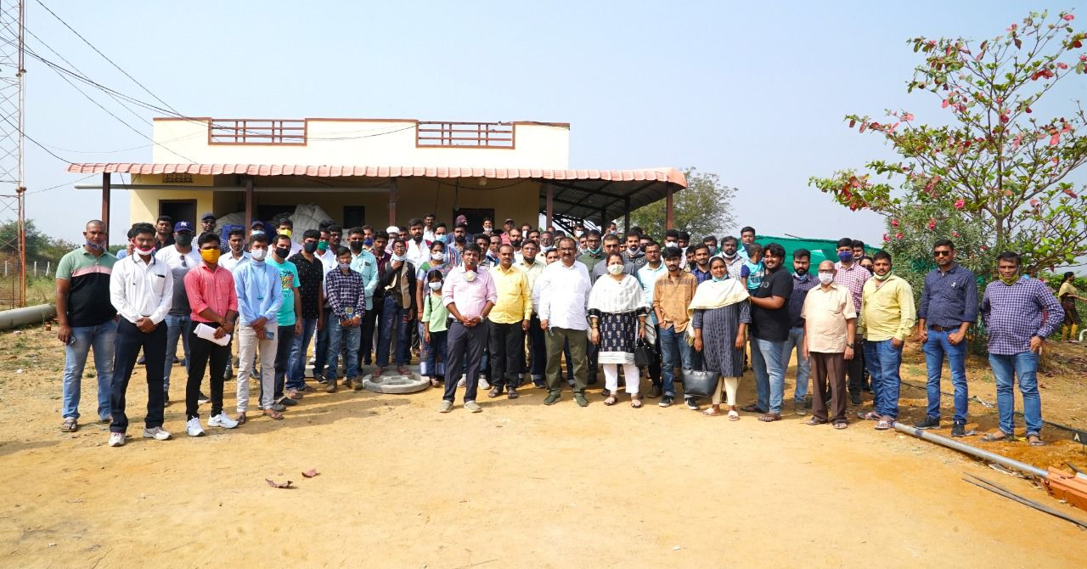
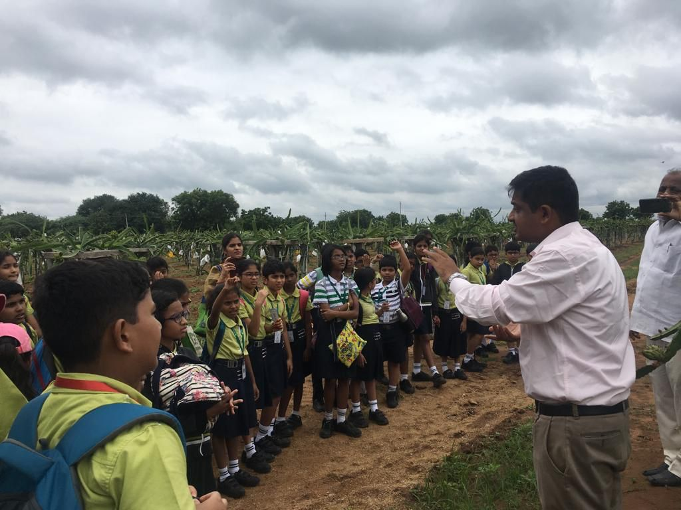
Conducting awareness programs to increase the popularity of Dragon Fruit to over 6000 farmers across India and knowledge sharing session with school children

Slide 13
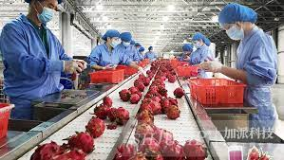
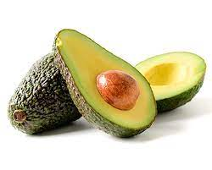
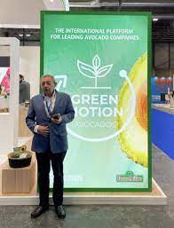



Upcoming projects by Deccan Exotics
  Establishing integrated pack house and processing centre in progress

Slide 14



WWW.DECCANEXOTICS.COM
FOLLOW US:
Call us:+91-7331155778, +91-7702071045.

