Slide 1

Cut Flowers-Opportunities & Trends
1st November 2022
National Horticulture Value Chain
Floriculture – Un Organized
Spreading Fragrance & Love in Our life
Flowers - Express your feelings without Words
Flowers - Change your Mood - Keep u peaceful
Flowers - Communication between Hearts
Flowers - Symbol of Love, Affection, Care
Flowers - Powerful weapon for world safety

Slide 2
Floriculture - India
Flowers – Part of our Indian Culture & Tradition , Approximately 12 lacks active temples in India which used average minimum of 2kgs of flowers per day, year average of 6kgs per day.
Around 5Cr people involved (Direct & Indirect) in flower industry(Farmer/trader/retailer/value adder/transport)
We use flowers from birth to death in our life , Traditional bonding between flowers and Indians.
We cant see a event without Flowers & Rural employment generation..
Other Usage's – Industrial usage , Fragrances, Natrual colours, Medicines , Ayurveda , recently edible flowers launched .

Slide 3
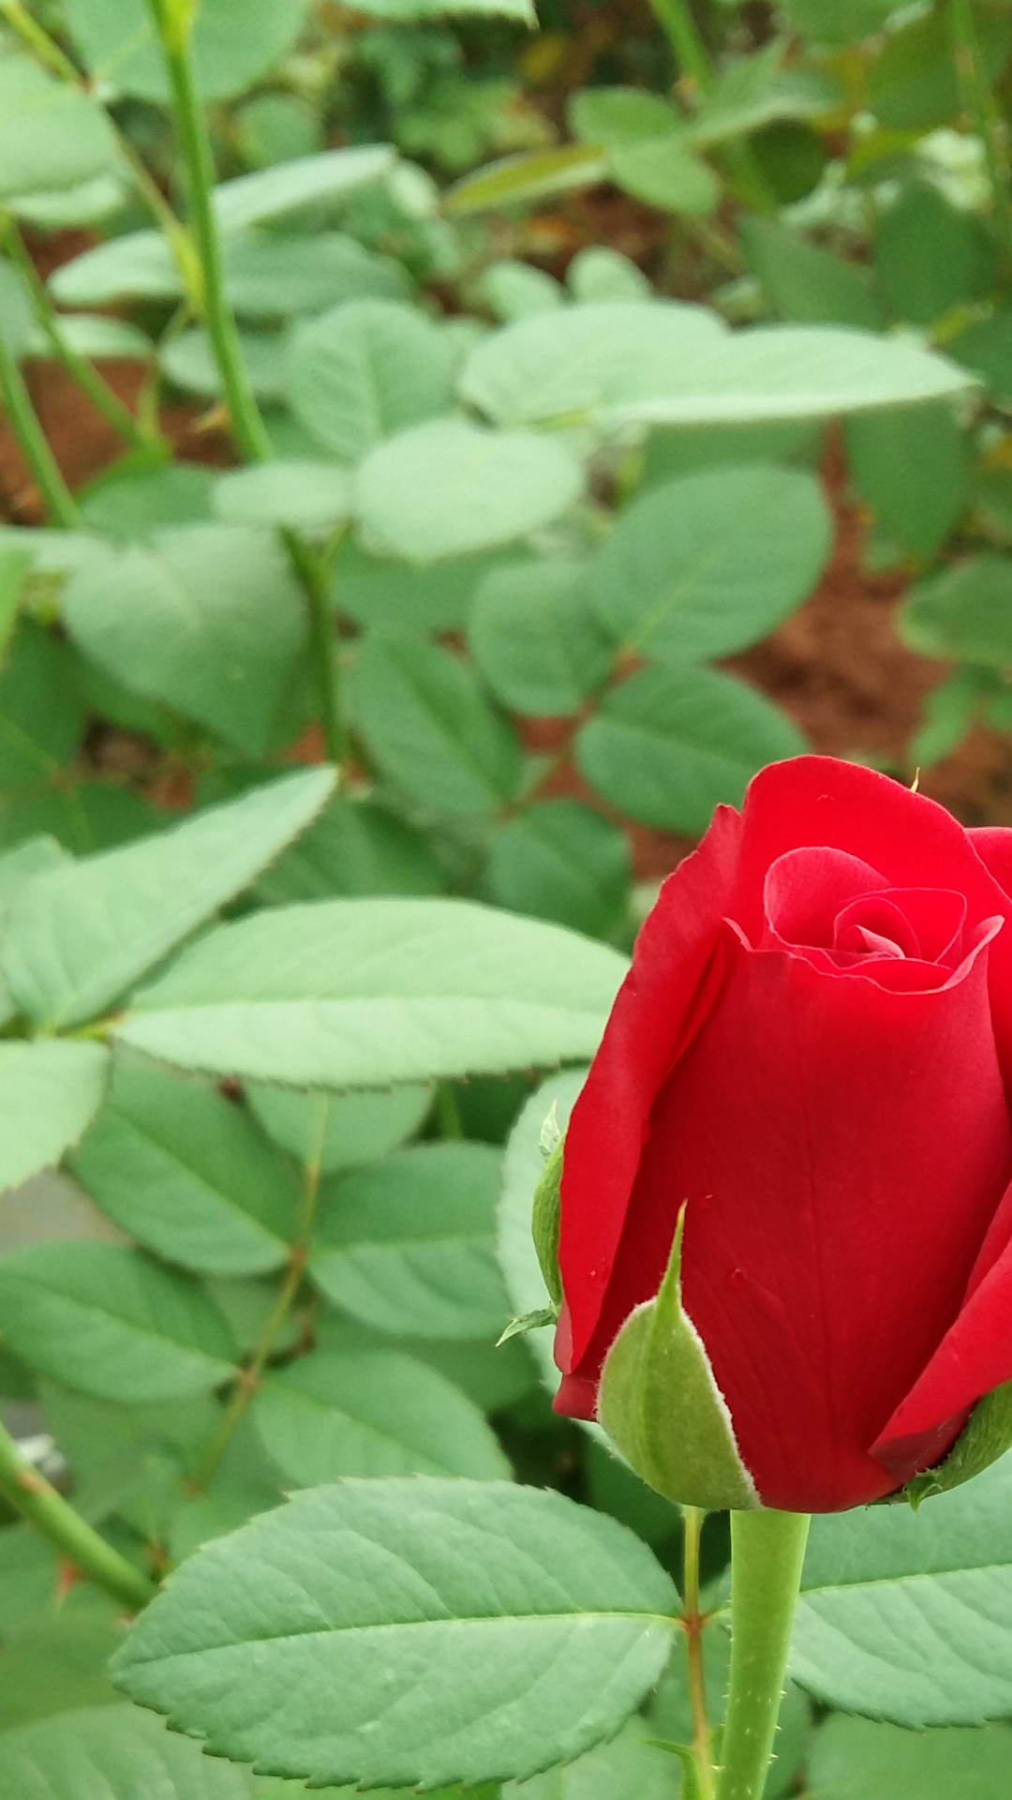
Trends world wide
Many country's contribute in their GDP growth of country -Netherland Columbia
Ecuador
Important days :Valentines day, Mothers day , Christmas , New-year, Hanukah – contribute over 70% of business in a year
Every Year fresh flowers consumption increasing by 12% so that demand increasing by 12% directly. In India it 6%

Slide 4
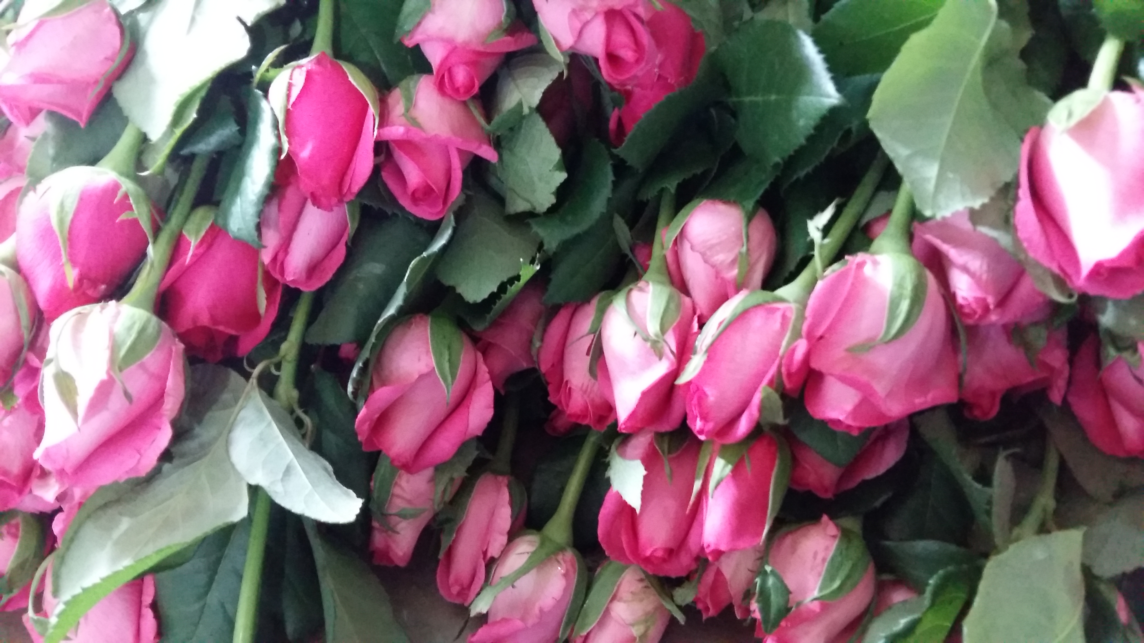
Cut Flowers & Loose Flowers
Dutch Roses
Gerbera
Carnation
Chrysanthemum
Orchids
Lily
Estoma
Rose
Jasmine
Chrysanthumum
Tube rose
Marigold
Crossandra
Ixora

Slide 5
Flowers Trade
International demand for good quality flowers is always high. Specially Indian flowers demand high due to its uniqueness.
Quality Quantity timely delivery plays important role in flower trade .
Country's like Singapore , Malaysia , Middle east where Indian population high – demand for Indian flowers also high. Where ever Indians travel they carry their traditions / Culture/ festivals along with them. Indians teach them about our culture.
As of now Fresh flowers and value added finished products like garlands , strings are high demand in exports.

Slide 6
Recent Trends
In India 365 days there is some type of demand for flowers - we have 145cr+ population, Apart from this every year we have 65 to 70 peak wedding dates & 25+ major festival dates which consume huge quantity of flowers.
As of now – Flower trade happens in localized flower markets & price fixed by traders , based on demand. Total flower wastage is 30% compare to global waste 45%.
Now GOI and State governments started focusing on flower industry around 15000cr money turnover in India per year.
Out of 365 days , Market prices
          high – 120 days (70 days very high + 50 days high)
          Average – 120 days(90 days good + 30 days average)
          Low – 120 days(60 days low prices + 60 days less sales with low prices)

Slide 7
Online Trade – Any Time Any Where
Recent years in India sending flowers through online become very popular, Ferns & Petals , InterFlora ,Blooms villa ,Flora India,MyflowerApp,phoolwala are few largest players in online flower delivery. Providing surprise flower gifts and make us happy on special days.
We can get multiple Collection of flowers , wide range of Designs & Combination of flowers on a click . We can get traditional flowers to exotic flowers on a single click, which we cant see on regular markets.
Online flowers delivery made considerable flower trade & providing opportunity's. We noticed many online company's buying directly from farmers – Transparency added.
In future online flower delivery will reach each and every corner of country(like amazon & flip cart ) , will play major role in future.
Daily basis pooja flower box(lose flowers,strings,small garland mixed combination) supply to households and mid range shops become popular trend in India .

Slide 8
Digital India Impact
Flower business become very simple after online payments started. Regular collection system(un accounted), credit system has reduced in recent days which help industry growth into next level.
Social media helps to connect farmers traders directly which eliminate middle man considerably
Farmers getting regular markets update, learning growing skills much better
Online flower trade platforms helps transparent trade

Slide 9
IFAC & IFAB
International Flower Auction Center – Hosur
Facility created by state government with investment of 20.20Cr to ensure transparent prices to farmers, where traders can buy flowers using their Mobile Phones from any part of the world.(pre fixed country's allowed). In IFAC middlemens are eliminated & fare prices to farmers has been assured. IFAC can handle 12lack stems of cut flowers per day – 67000 sqft buildup area.
International Flower Auction – Bengaluru
Past 20 years running market for cut flowers which helps lot of farmers to get into floriculture
Timely payments to farmers and fare prices ensured
Year average 2lack stems per day handling- 32000sqft buildup area
Apart from regular traditional flower growers , recent years IT/BT , Corporates investing into floriculture industry (demand & Government support)

Slide 10
As of now we are contributing less then 1% in international market, even we have good climatic zones and altitude ranges from 850m to 1200m from sea level, we have less then 10000 acres of Polyhouse in India for commercial floriculture
Cut flower industry plays major role in rural employment , providing high wages compare to other agriculture industry's,
Many country's GDP depends on floriculture, We can earn more dollars by exporting quality fresh flowers , We need to upgrade our cultivation technology based on international demand, Quality of produce plays very important role in exports. We need to train our growers to meet international standards.

Slide 11
Facts to Consider
Quality planting materials & Updated variety's timely not available
Need regular guidance & training to farmers to ensure quality production, In floriculture quality only matters.
Excess usage of fertilizer and chemicals without proper technical support
High cost of production compare to international competating country's.
Due to un trained workers- our post harvest loss is high, we don’t have proper grading packing machinery to reduce losses and maintain quality standards. Domestic cargo transportation damage's accounts 20% loss to industry.
High transportation cost and cargo charges, we are not able to reach competitive price in international markets.
As of now floriculture is an un organized business sector in India. Need to setup separate board for floriculture like coffee board , coconut board.
Inseated of importing plants and varieties , we need to have research and development, which should compitate in international markets.

Slide 12
In India majority of farmers holds 1acre to 3acres , which is not suitable for setup a export oriented cut flower unit. Export unit at least 10 acres required to achieve quality and quantity
Need to work on FPO/Farmers Federations/Farmers associations
We have equal amount of opportunities and challenges in industry. Government should give importance to flower industry which is un organized.
GFCI – Grower Flower Council Of India – Organization for development of floriculture in India , Working from root level to develop floriculture ,
We are fighting with Artificial Flowers / Artificial Decorative items which is imported from China(97%) , Need bold steps to #BANARTIFICIALFLOWERS #STOPARTIFICIALFLOWERS

