Slide 1
Role of Technology & Innovation in Horticulture in India
Debi Sharma
ICAR-IIHR, Bengaluru

Slide 2
Innovations in Horticulture
Technological Innovations - played a significant role in horticultural development in India.
The Horticulture sector in India produces around 340 million tons of products and contributes to about 33% of the Gross Value Addition (GDA).
Productivity of horticultural crops increased by 38% between 2004-05 and 2019-20.
High yielding, disease resistant, high quality, varieties
Innovative production technologies & interventions for higher seed/planting material production
Post Harvest Management, uniform ripening, increasing shelf life
Plant Health Management- Bio pesticides, Bio fertilisers, insect traps
Ensuring Food Safety

Slide 3
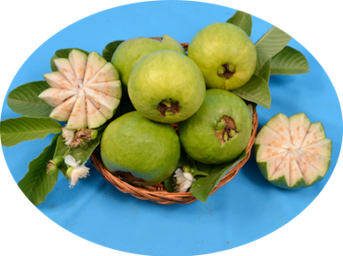
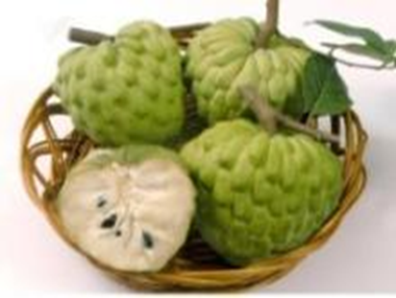
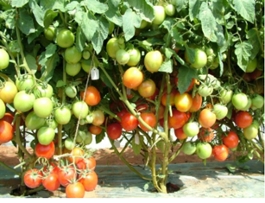
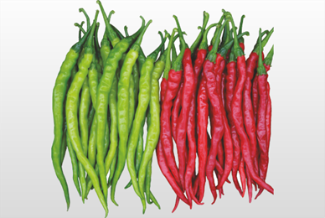
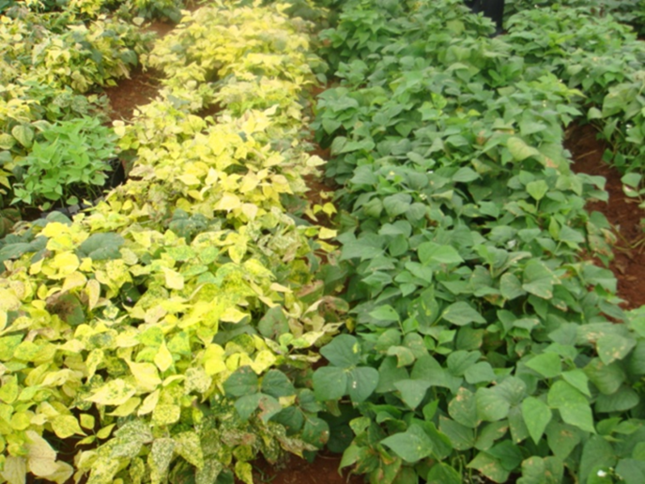
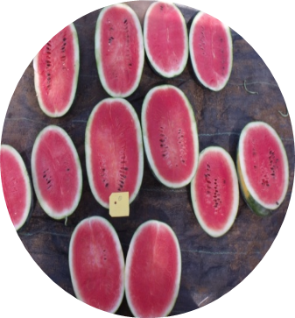
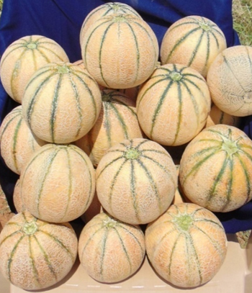
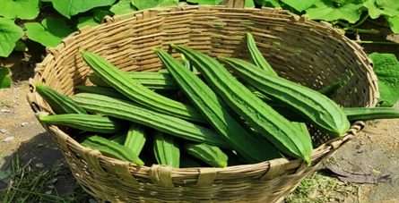
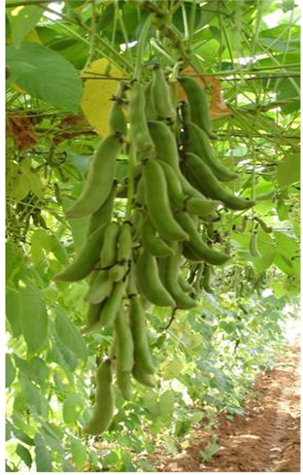
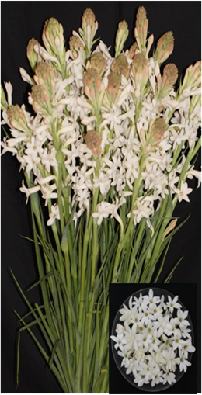
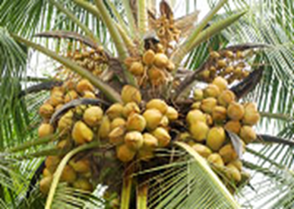
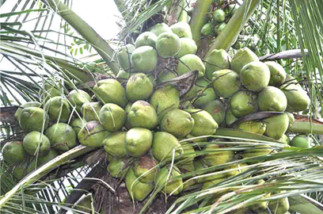
Varieties for Increased Productivity & Disease Resistance
ICAR-IIHR
Guava – Arka Poorna, Arka Kiran – 32 -38t/ha
Custard Apple – Arka Sahan – 18 -20 t/ha
Tomato – Arka Rakshak, Arka Abhed - 100-120 t/ha (MDR)
Chilli – Arka, Tejasvi, Arka Gagan, Arka Saanvi, Arka Tanvi – 5-6 t/ha(LCV),
Arka Meghana – (Powdery Mildew & Virus resistant)
French Bean – Arka Arjun -18t/ha (YMV)
Watermelon – Arka Shyama – 60-70 t/ha
Musk melon - Arka Siri – 25t/ha
Ridgegourd – Arka Vikram – 34t/ha
Tuberose – Arka Prajwal – 17t/ha
Velvet bean – Arka Dhanvantari, Arka Shubra – 4-4.5t /ha
Coconut: Chandra Sankara, Chowghat Orange Dwarf
Kalpashree (Resistant to root wilt -ICAR-CPCRI)
2 to 6 fold increase in yield

Slide 4
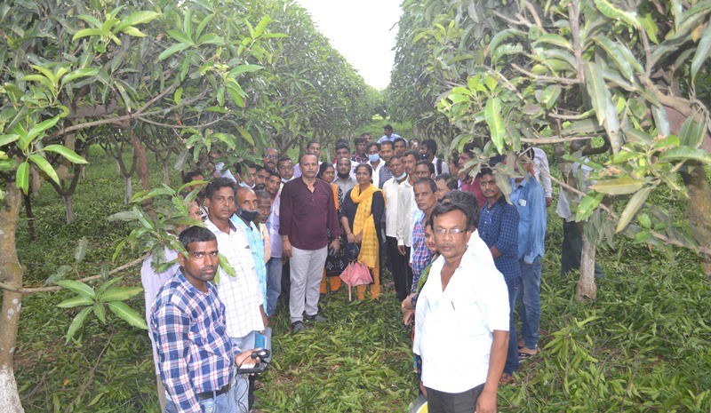
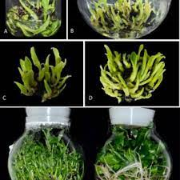
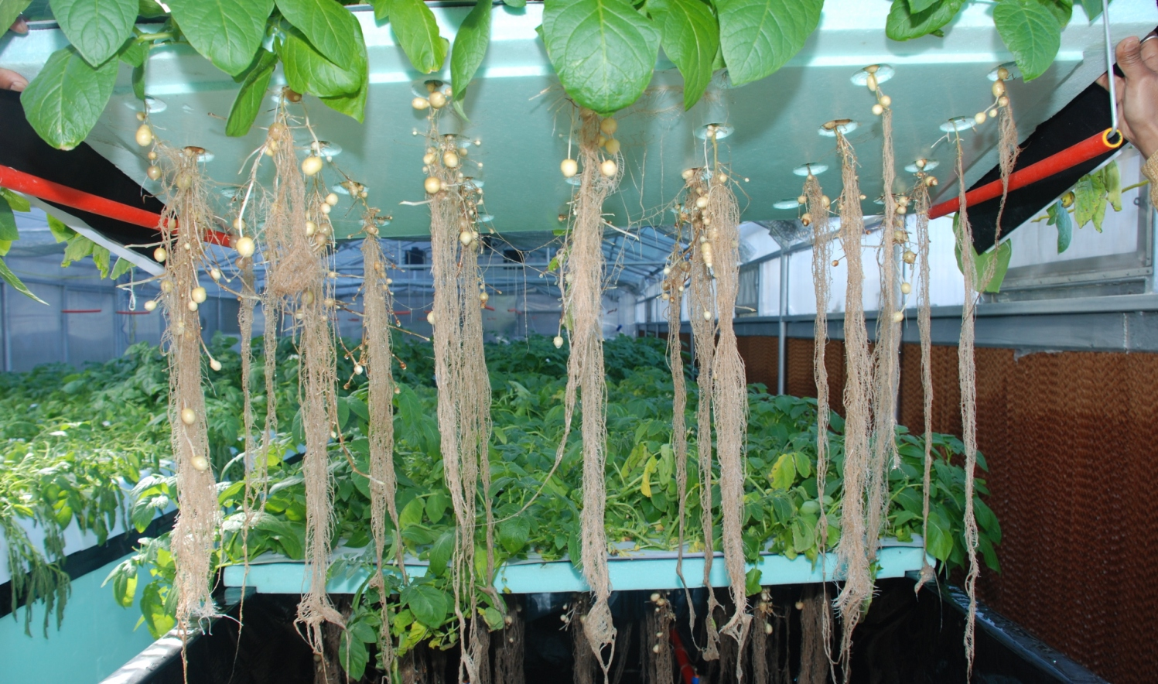
Innovative Production Technologies
New Generation Tissue Culture System
ICAR-NRCB -
customized bioreactor (SERV) and standardized the protocol for mass multiplication of Bananas using somatic embryos.
One ml of Embryogenic cell suspension can produce approx. 40000 (cultivar specific) plants within 160 days
Root Stocks
Grape : Dogridge and 110R drought and salinity ( 56% area income gain 790 crores)
Citrus rootstock Alemow : Resistant to Phytophthora (root rot & gummosis)- increased yields two times
Citrus : Rangpur Lime – drought resistance
Mango : Vellaikulamban –dwarfing
(ICAR –IIHR)
High Density planting
Plant Architecture Engineering Enhancing resource efficiency , quality of produce and reduced cost of production
Y-trellis system for Mango, Grape
HDP in guava, fig (ICAR-IIHR)
Aeroponic system for potato minituber production - 7 to 10 times more number of minitubers from in-vitro plantlets (ICAR-CPRI)

Slide 5
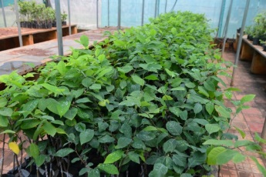
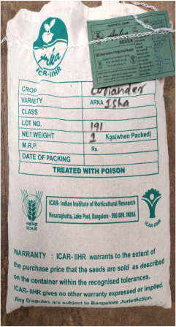
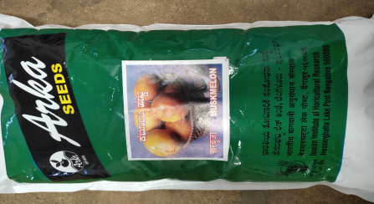
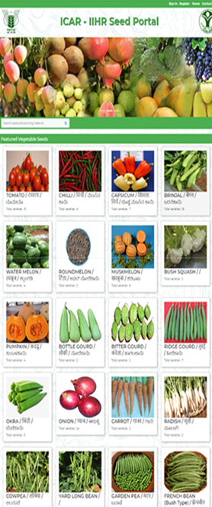
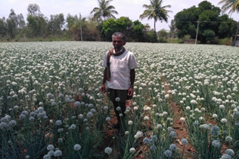

Seed and Planting Material Production under Seed Village Concept – A Success Story
Group of farmers in a village /villages is selected - Agreement to procure seed at predetermined price
Seed production programme is mainly concentrated in Davanagere, Chitradurga, Haveri, Bengaluru rural, Mandya, Ramanagar, Tumkur, Koppal and Chikkaballapur districts of Karnataka, Krinshnagiri & Dharmapuri districts in Tamil Nadu, Ananthapur in Andhra Pradesh & Nasik in Maharastra
Around 43 tonnes of Vegetable seed, 2.23 lakh fruit plants, 13 lakh ornamental & 1.11 lakh medicinal & aromatic planting material worth about Rs. 9.00 crores, were produced during 2021-22.
About 70 farmers benefitted by this programme during 2021-22. Farmers are getting at least 2 times more income from seed crop than from commercial crop production – guaranteed income.
Sale linked to SBI’s Yono app and ICAR-IIHR website

Slide 6
Post Harvest Management
New generation controlled onion storage structure
Capacity to store onions for six months with minimum storage loss of only 15% ( varying capacities of
< 1 tonne, 2tonnes, to 2000tonnes - ICAR-DOGR)
Safe and low cost ripening technology of fruits
A simple method standardized at ICAR-IIHR for enhancing the ripening process by exposing the fruits to ethylene gas released from liquid ethrel/ethephon.
Uniform accelerated ripening

Slide 7
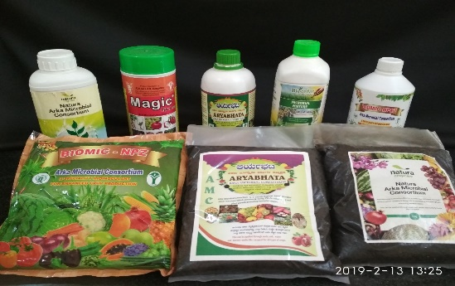
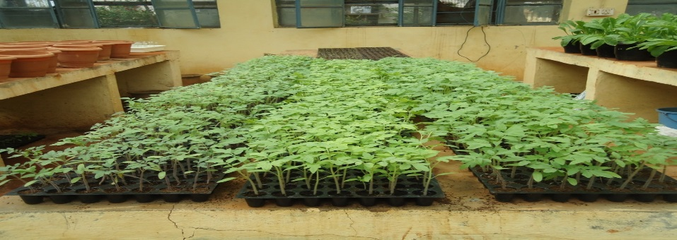
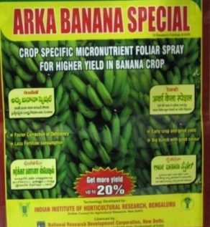
Plant Health Management
Bio fertilisers - Arka Microbial consortium-A carrier based consortium of beneficial microbes for horticultural crop production
Arka Fermented Cocopeat- A novel substrate for seedling production
Micronutrient formulations custom made to suit specific crop needs-
Arka Banana special,
Arka Vegetable special,
Arka Mango special
Notified by GoK as per FCO
ICAR-IISR developed ‘A Novel Method of Storing and Delivering PGPR/ Microbes through Biocapsules’- An alternative to existing biofertilizer formulation (talc/ liquid/peat based etc.)
Process involves encapsulating any agriculturally important microorganism in a gelatine capsule.

Slide 8
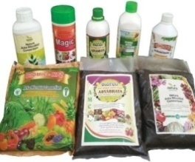
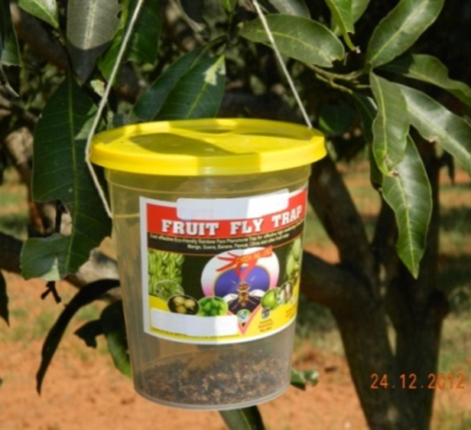
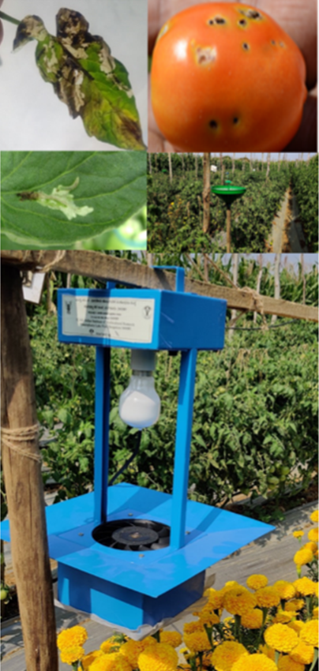
PHM-Ecofriendly Crop Protection – Biopesticides, Traps
1 | Bio-nematicide – Paecilomyces lilacinus (=Purpureocillium lilacinum) 1% W. P.
2 | Bio-pesticide - Trichoderma harzianum – 1% W.P
3 | Bio-pesticide - Pseudomonas fluorescens – 1% W.P.
4 | Bio-pesticide - Trichoderma viride – 1.5% W.P
5 | Bio-nematicide - Verticillium chlamydosporium (Pochonia chlamydosporia) – 1% W.P
Data generated for registration
Under 9(3) CIBRC
Fruit fly traps
Arka Tuta trap -Light cum suction trap

Slide 9
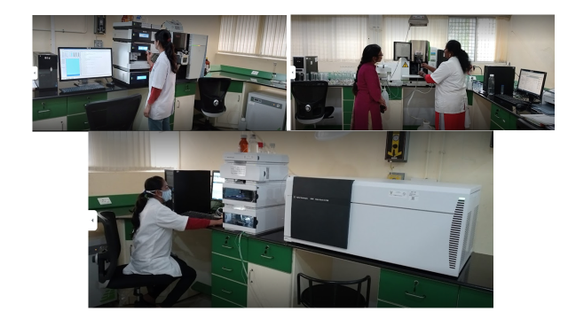

Ensuring Food Safety
NABL Accredited National Reference Laboratory at ICAR-NRCG Pune
Grapenet - first comprehensive food safety-traceability system of the country - enhanced export of grapes from 300 containers a year (2003-3004) to the current volume of 9000 containers per year.
Minimized non-compliance of the export consignments to EU-MRLs from 23.7% in 2004 to 1.8% in 2021-22
Value of exported grapes increased from Rs. 428 crores (2010-11) to Rs. 2302 crores (2021-22)
NABL Accredited Food Safety Referral Laboratory at ICAR-IIHR, Bangalore
First laboratory (ICAR) accredited for chemical as well as biological testing in food,
Referral laboratory of FSSAI, tests fruit and vegetable products for compliance as per FSSR 2011
Removes 80-100% of surface residues of pesticides and 90% spoilage organisms from fruits & vegetables

Slide 10
Thank you

