Slide 1
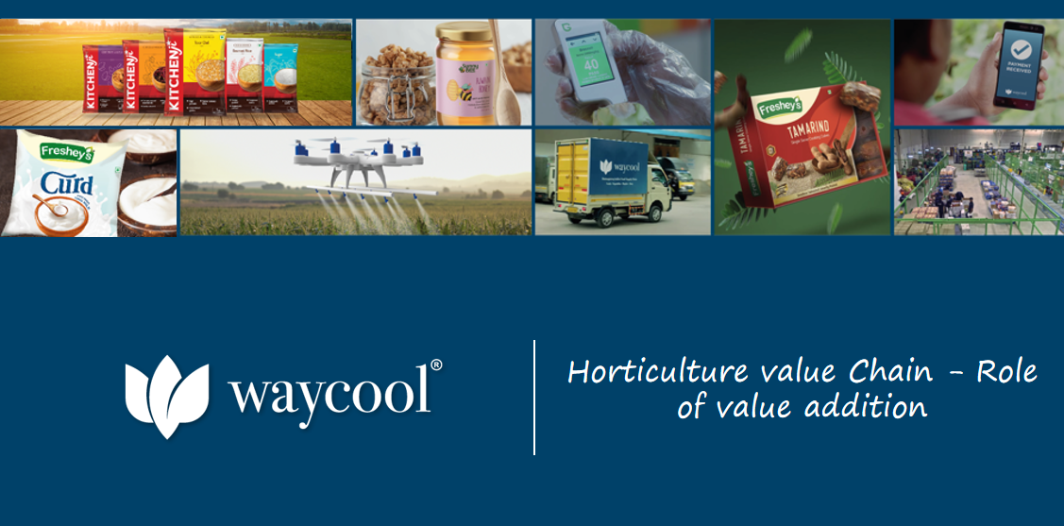

Slide 2
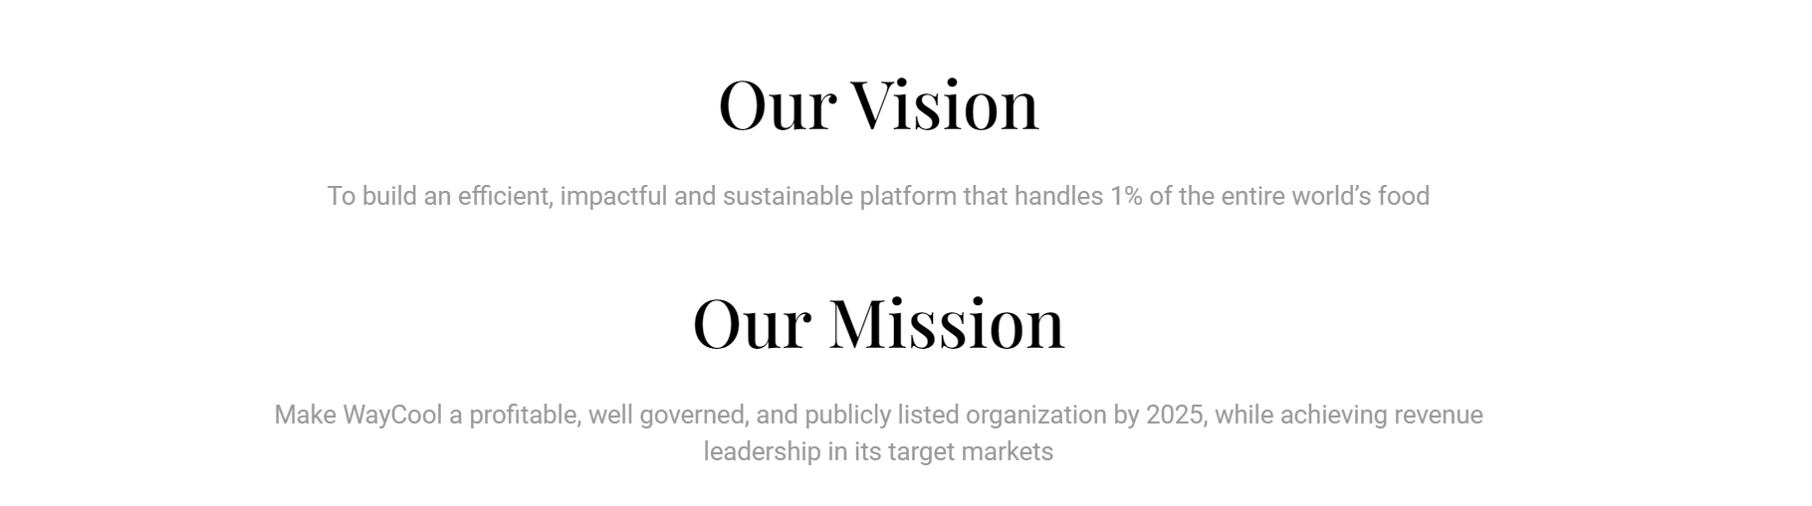

Slide 3

Challanges we faced in Tender Coconut
In each Full truck vehicle small size, Brown patches, mites, without cap material available minimum 20%
Sudden climatic changes slow down demand
Market price fluctuation
Chopped coconut can’t be stored
Multiple handling impacting qualitry of nuts
Loss of margin

Slide 4
Flow of Process
Harvesting
Washing
Treaming
Dipping
Surface Drying
Storage/Transportation

Slide 5
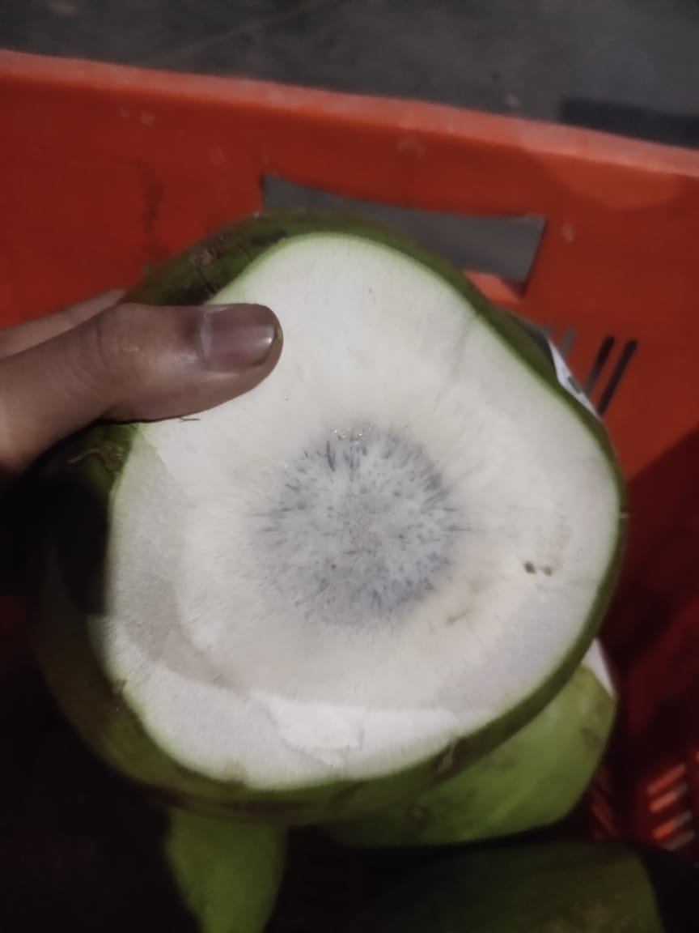
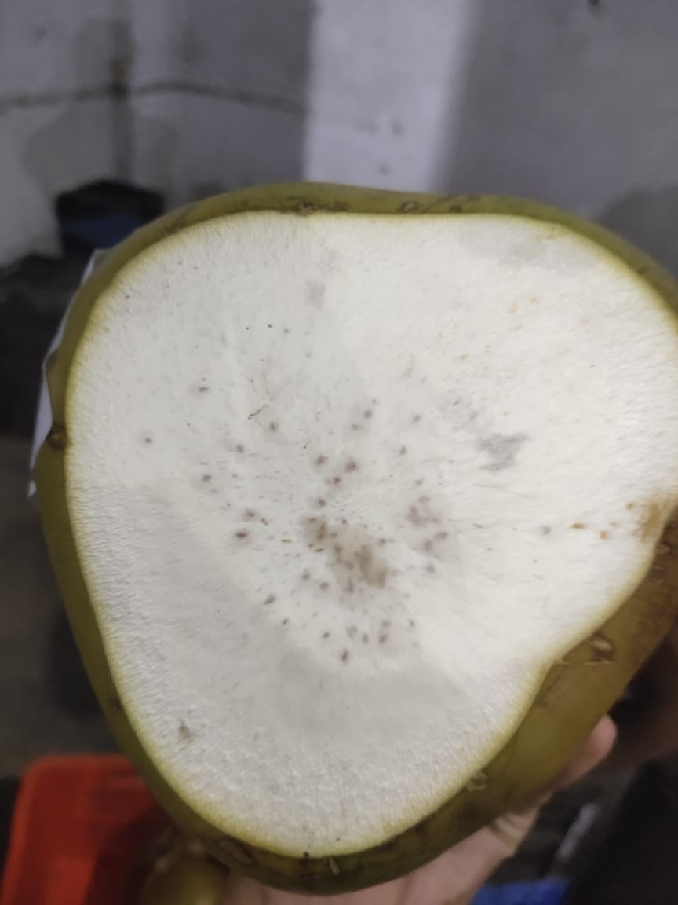
Process
Harvesting
Washing
Treaming- Manual(40 nuts/hr), Semi automatic(1-2 nuts/min), fully automatic air compressor (4-5 Nuts/min)
Dipping in Chemical Solution
Surface Drying- Shade drying after immediate dipping
Storage/Transportation

Slide 6
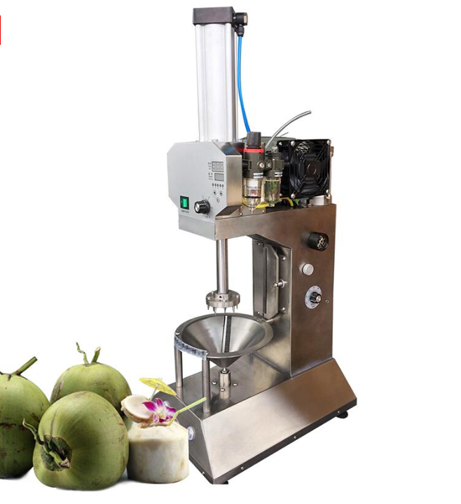
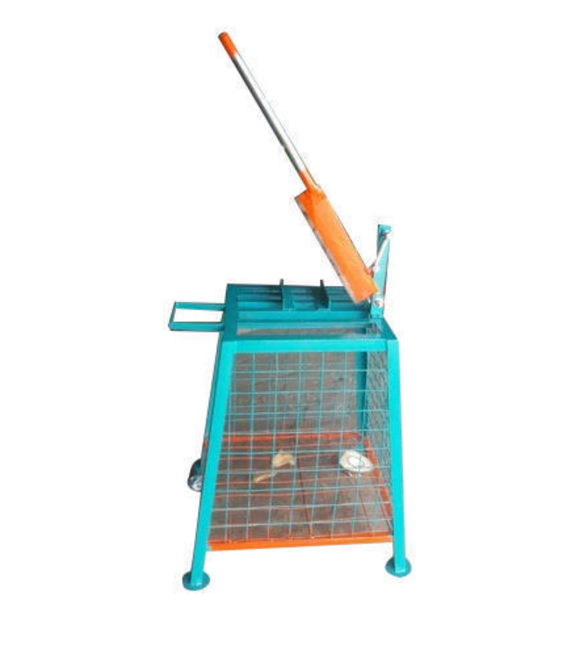
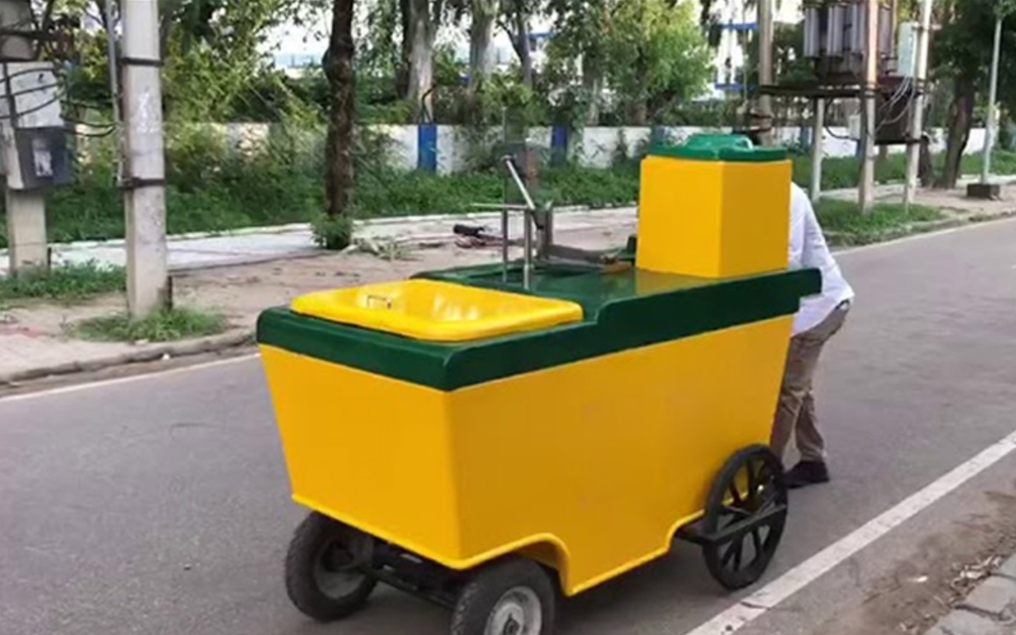
Triming machies

Slide 7
Triming and Dipping proocess
Dipping in chemical solution
Act as anti browning solution
Control the activity of enzymes such as Polyphenol Oxidase (PPO) and Peroxidase (POD).
Treated with the solutions of 0.5% potassium metabisulphite (KMS) and 0.5% citric acid for three minutes.
Need to dry properly on priority to avoid fungal growth

Slide 8
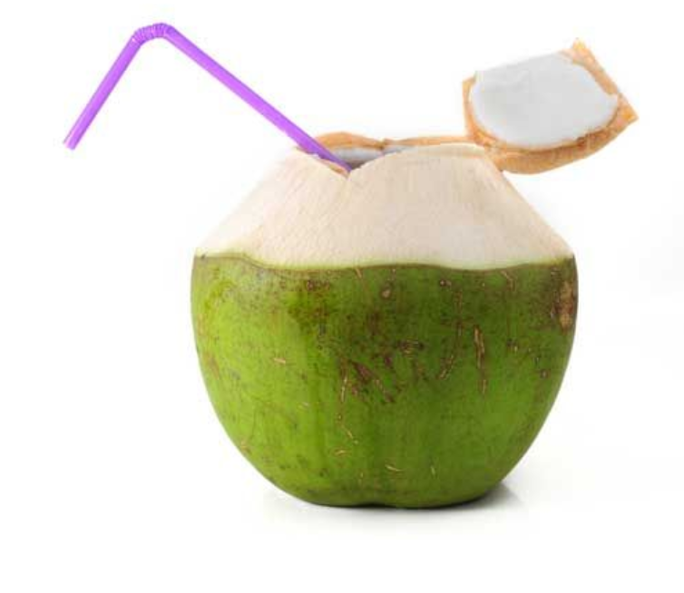
Benifits
Increasing shelf life of nuts, can store for week at controled temperature max 26 Days it can be stored
Good market opportunities across vertical Retail, MT, Kam
Triming and dipping process reduce losses and increase margin
No impact on quality of material and its nutritional value
Chemical dipping cost nearly 1.5 Rs. Per Pc
Can Get additional margin upto 20-25% across market.
Fast moving and high demand in MT now a days trroughout the year.

